Slide 1
PCMH Screening Snapshot
Blueprint for Health QI Facilitation Network
July 2022

Slide 2
PCMH Screening Field Survey
9 questions total
Conducted early July 2022
73 (included) responses
47% Hospital Owned, 31% independent, 22% FQHC
Representation from 11 H.S.As
91.5% indicated that universal screening (all practice population) is occurring
Notes:
Some QI facilitators completed themselves based on knowledge/conversation, some forwarded and had practices complete-40/60 mix
OBGYN Practice data removed so data represents PCMH only
47% Hospital Owned, 31% independent, 22% FQHC
Most frequently, pediatric practices indicated that they are only screening a subset of their population for MH, Substance Use, and SDOH

Slide 3
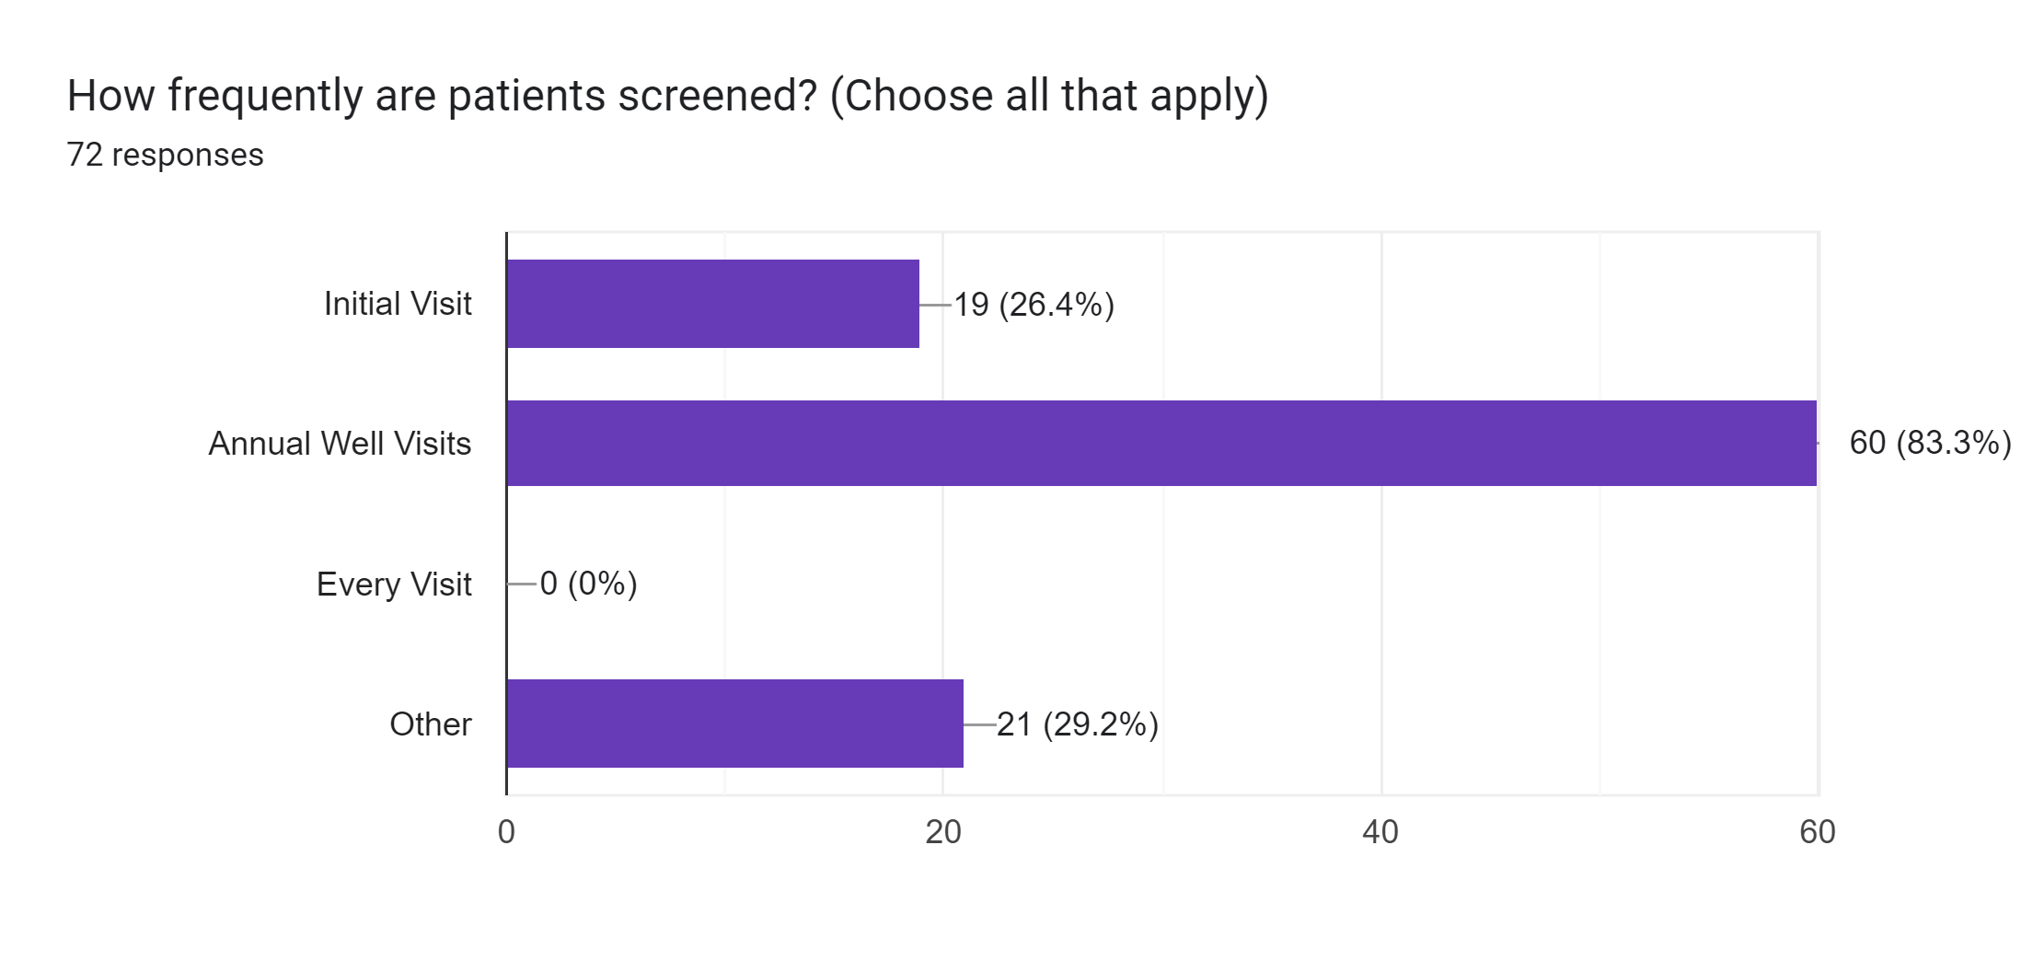
Timing of Screening
Notes:
Other responses typically indicated that screening would occur at provider discretion; typical workflows would involve annual well visit, but the decreased rate of annual visits and increased needs of the population has resulted in some practices screening during sick visits or routine care
Answer guidelines were to check all that apply

Slide 4
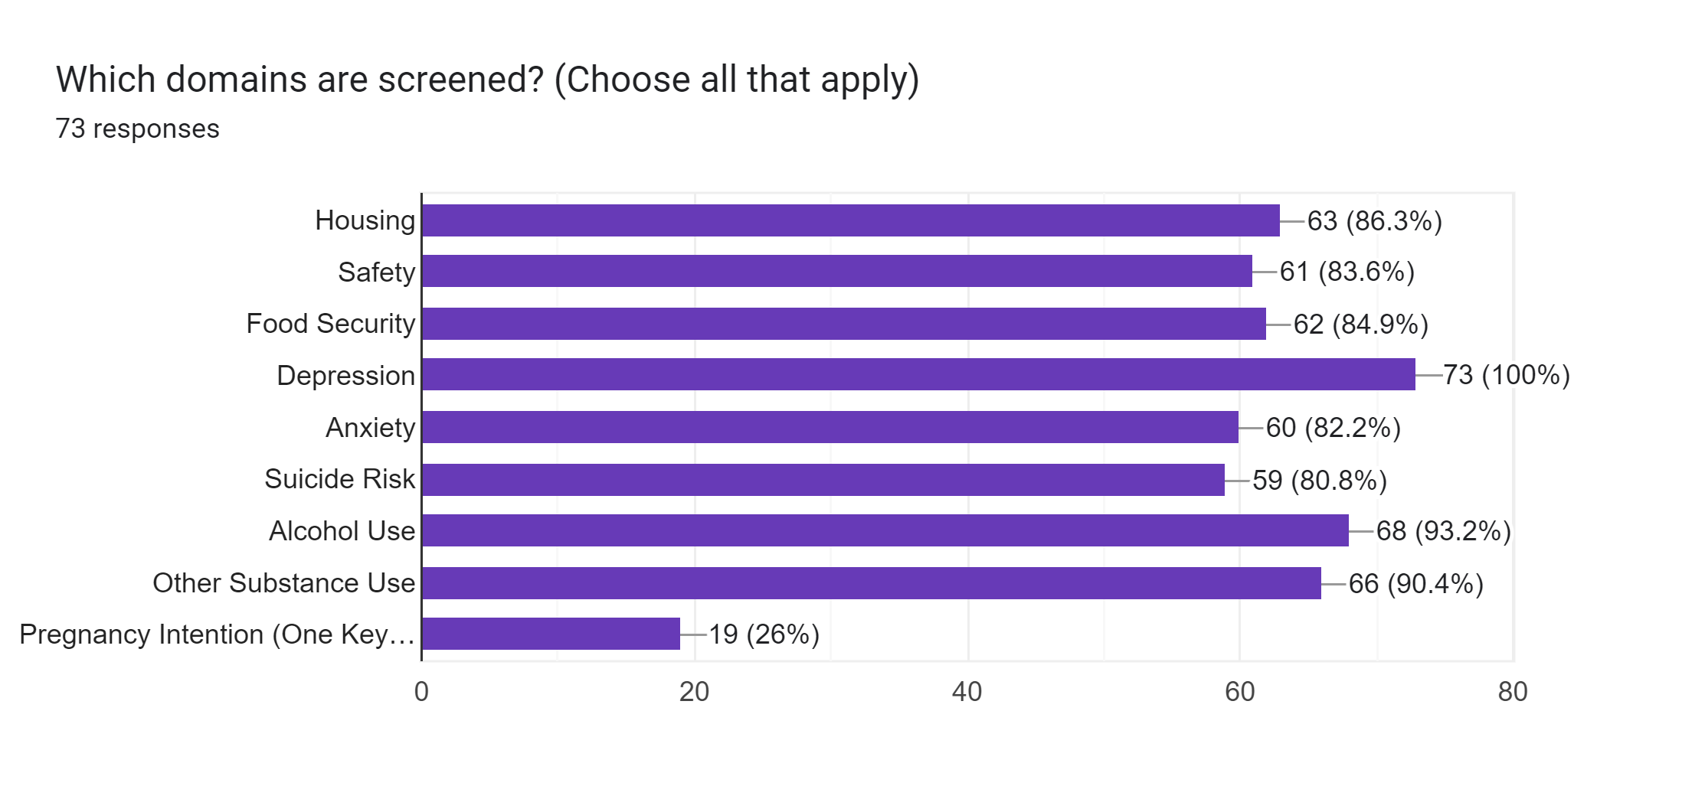
*One Key Question is a requirement of WHI participating practices; only a subset of PCMH practices participate
Notes:
Pregnancy Intention screening is a requirement of WHI participating practices, only a subset of PCMH practices participate in this initiative

Slide 5
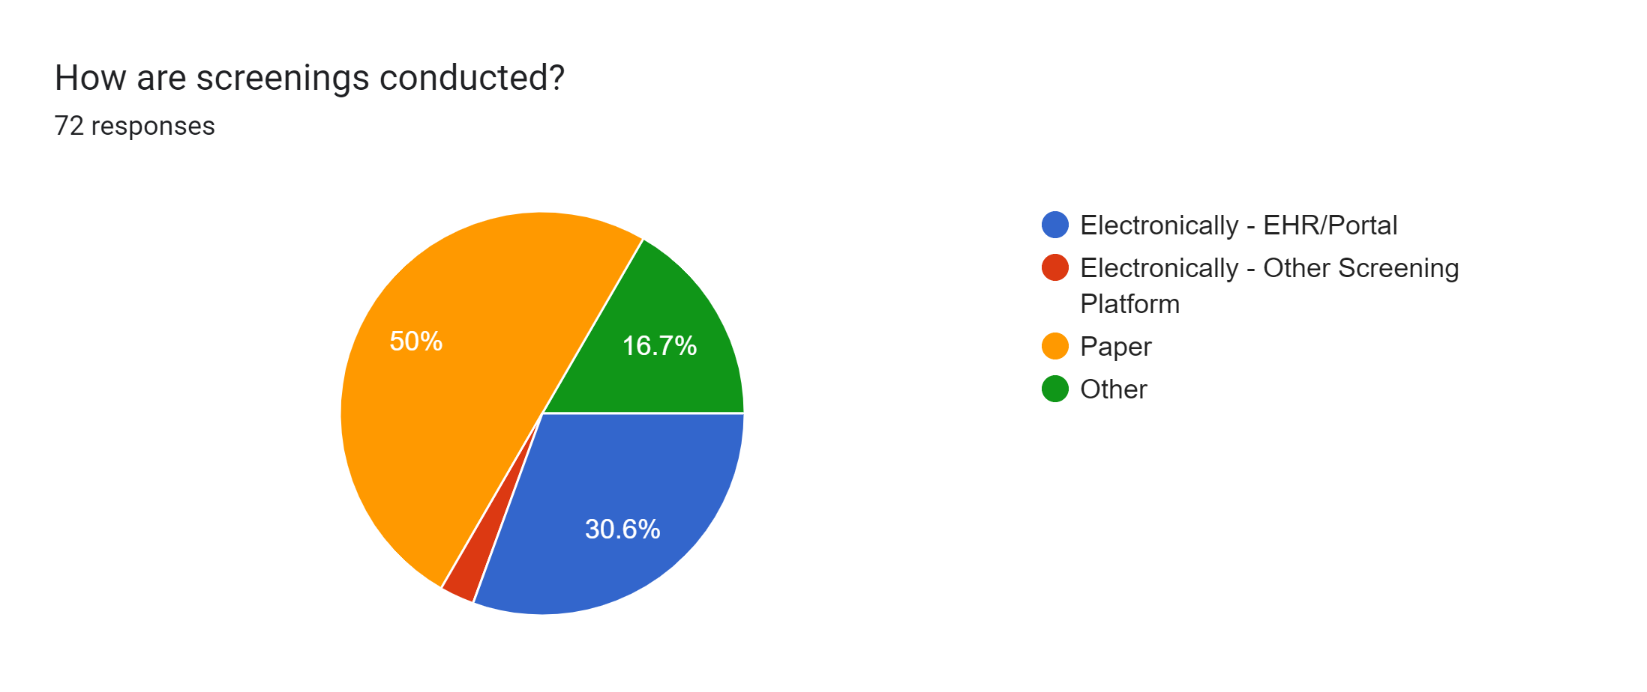
Notes:
Half of the practices that responded are conducting screenings and then keying or scanning into E.H.R
Electronic Screening Platform (n=2), CHADIS
Other – provider directly asks questions, or mix of paper and electronic
Best intent is electronic sent via portal but also catch in waiting room with paper

Slide 6
Current Unknowns
Access
Vermonters not associated with a primary care practice
Screening
Which screening tools are typically used
Positivity rates
Screening practices in other settings (Emergency Departments, Mental Health Agencies, Schools, etc.)
Brief Intervention
Warm-hand off/same day intervention rates
Who provided intervention
Provision/duration of on-site short term mental health and substance use treatment following positive screen for clinically appropriate cases
Provision of care coordination services
Follow Up
Specialty and community referrals made
Referral loop closure

Slide 7
Questions or feedback?
Julie Parker, Assistant Director
Julie.parker@vermont.gov
Erin Just, Quality Improvement Coordinator
erin.just@partner.vermont.gov

