Slide 1





CHT FTE Distribution
CHT Distribution by Staff
14
2.2
5.29
4
(8%)
3.86
(5%)
(2%)
(2%)
Care Management
(includes care coordination and counseling)
6.2
(3%)
13
(5%)
(8%)
Panel Managers
11
(6%)
CHT Oversight
and Admin
135
Health Educators
100.57
(76%)
(85%)
Registered Dietician /
Nutrition Specialist
Total: 177 Staff
Total: 118.04 FTE

Slide 2
CHT FTE Distribution
CHT Distribution by Staff
14
2.2
5.29
4
(8%)
3.86
(5%)
(2%)
(2%)
Care Management
(includes care coordination and counseling)
6.2
(3%)
13
(5%)
(8%)
Panel Managers
16.69
11
(6%)
(12%)
Licensed Mental Health Clinicians
CHT Oversight
and Admin
Licensed Mental Health Clinicians
21
4.8
(12%)
135
Health Educators
100.57
(76%)
(4%)
Community Health Workers
(85%)
5
Community Health Workers
Registered Dietician /
Nutrition Specialist
(3%)
Total: 177 Staff
Total: 118.04 FTE

Slide 3
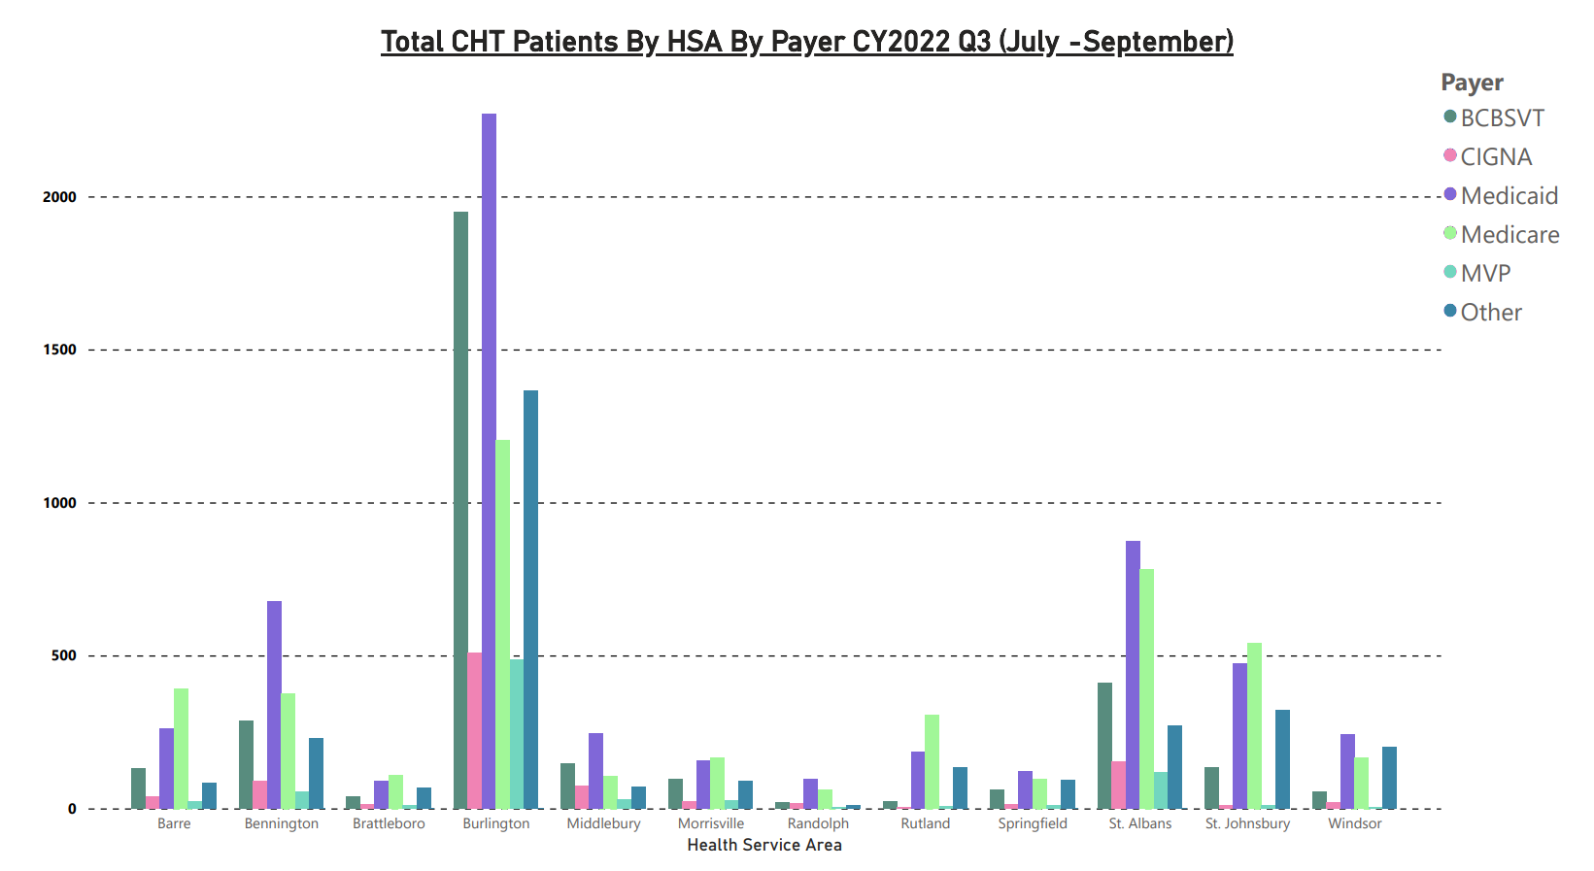

Slide 4
