Slide 1
“Vermont ACH 101”
Accountable Communities for Health in Vermont
September 2018

Slide 2
What is an Accountable Community for Health?
Accountable for the health and well-being of the entire population in its defined geographic area
Supports the integration of high-quality medical care, mental and behavioral health services, and social services for those in need of care
Supports community-wide prevention efforts to reduce disparities in the distribution of health and wellness.

Slide 3
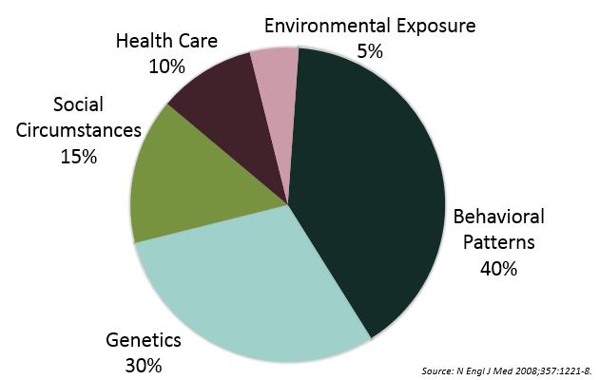
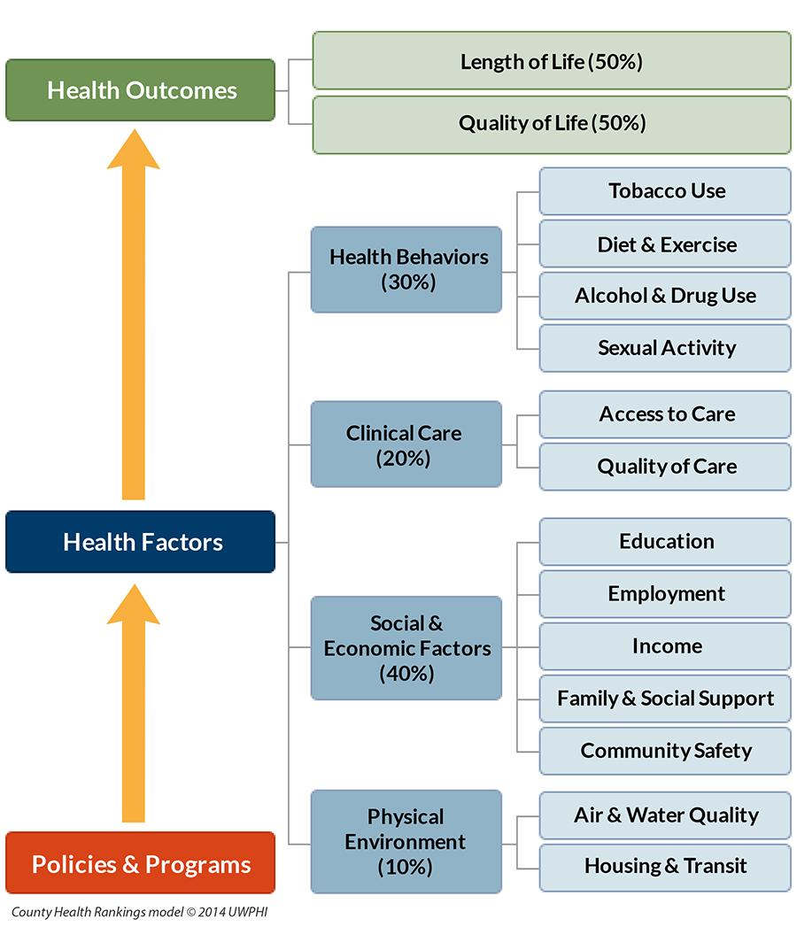
Foundational Concepts: Population Health Impacts

Slide 4
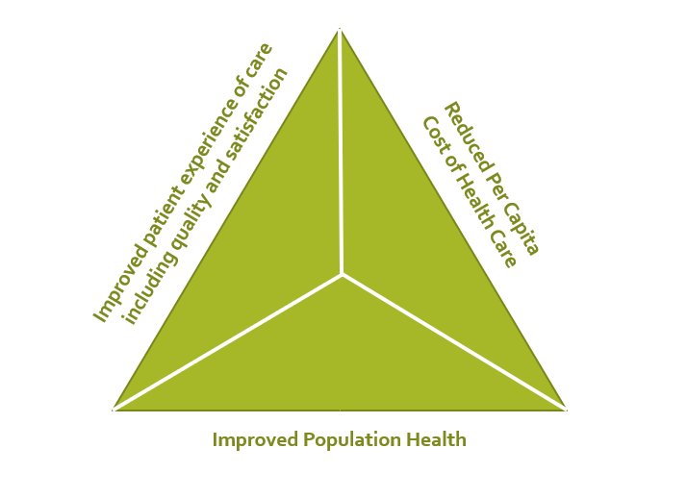
Foundational Concepts: The Triple Aim
Source: http://www.ihi.org/Engage/Initiatives/TripleAim/Pages/default.aspx

Slide 5
Timeline of initiatives informing ACH
2010: Accountable Care Act (ACA) passes
2011: Green Mountain Care Board created (VT Act 48)
2012: Three Accountable Care Organizations (ACOs) created in VT
2013 – 2015: State Innovation Model (SIM) grant funds Vermont Health Care Innovation Project (VHCIP)
2013: VHCIP Population Health Workgroup created
2015: Population Health Workgroup recommends exploration of Accountable Communities for Health model in VT
2016: Unified Community Collaboratives formed
2013: RCPCs formed
2015 – 2017 ACH Peer Learning Lab convenings take place
2018: All HSAs have explored or created ACH framework

Slide 6
Community Based Workgroups – Roles
Regional Clinical Provider Councils (RCPC)
Who: Primary care, ACOs, Blueprint staff
Emphasis: clinical measures and outcomes (BP & ACO measures)
Triple aim goals:
Lower costs
Improved health of population
Unified Community Collaboratives (UCC)
Who: Primary care, care coordination staff, and key social service providers in each HSA
Emphasis: Reduce duplication, clarify roles, and identify gaps in supporting services
Triple Aim goals:
Lower costs
Improved health of whole population
Patient Experience
Accountable Community for Health (ACH)
Who: Cross-sector community membership
Emphasis: clinical and non-clinical determinants of health; Integrated services; Health of whole population
Triple Aim goals:
Lower costs
Improved health of whole population
Patient Experience

Slide 7
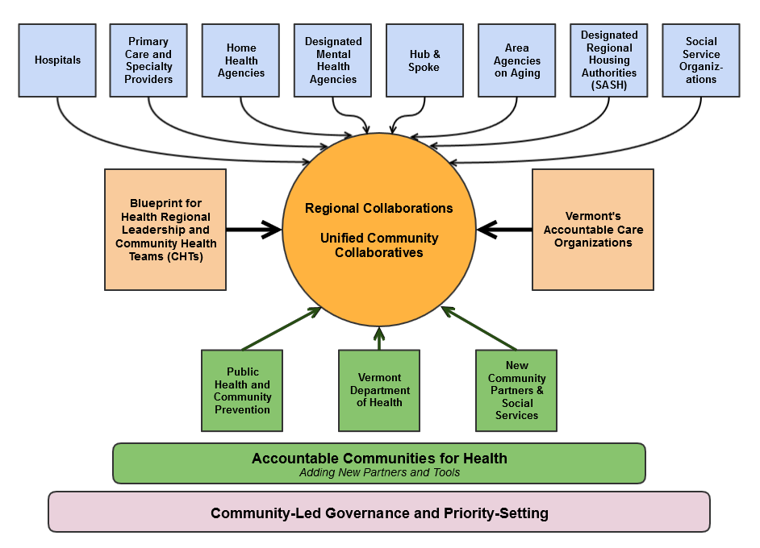
Vermont: Regional Integration

Slide 8
Moving towards increased community engagement and trust
UCC
CC
ACH
RCPC
Hospital and Primary Care | Expanded Health System | Community Partners
+
+
Need for trust between groups to increases

Slide 9
Vermont ACH Framework
State Leadership Team*
Bennington Community Collaborative
WINDSOR Community Collaborative
Upper NEK Community Council
THRIVE
(Washington)
Springfield Community Collaborative
ARCH
(Rutland)
Community Health Action Team (CHAT) Addison
Chittenden ACH (CACH)
Morrisville
Area ACH
Randolph Executive Community Council
Brattleboro
ACH
NEK PROSPER
(St. J area)
*Recommendation from VT ACH Peer Learning Lab

Slide 10
9 Core Elements of an Accountable Community for Health Model
Mission
Multi-Sectoral Partnership
Integrator Organization
Governance
Data and Indicators
Strategy and Implementation
Community Member Engagement
Communications
Sustainable Funding

Slide 11
ACH: 9 core elements
Mission – A shared vision is an agreed understanding of the problems being solved, and states what the ACH membership wants to achieve together. This acts as a critical foundation for guiding the ACH mission and goals. An effective ACH mission statement provides an organizing framework for the work. A strong mission defines the work as pertaining to the entire geographic population of the ACH’s region; articulates the ACH’s role addressing the social, economic, and physical environmental factors that shape health; and makes health equity an explicit aim.
Multi-Sectoral Partnership – An ACH comprises a structured, cross-sectoral alliance of healthcare, public health, community members, and other organizations that impact health in its region. Partners should include the breadth of organizations that are able to assist it fulfill its charge of implementing comprehensive efforts to improve the health of the entire population in its defined geographic area. The cross-sector partnership should include champion leaders – both individuals and organizations among the core entities of an ACH – who can ensure work continues to move forward.
Integrator Organization – To maximize the effectiveness of the multi-sectoral partnership, it is essential for the ACH to have an integrator organization. The integrator helps to carry the shared vision, mission and goals towards the creation of an integrated system for health and wellbeing in their geographic area and is built on the trust amongst collaborative partners. Key activities of an ACH include: coordinate services, members and other activities; convene partners and community members; business and budget management; data collection, analysis, and evaluation; facilitating agreements; recruit new partners; shepherd the planning, implementation, and improvement efforts of collaborative work; and build responsibility for many of these elements among collaborative members.
For more information go to: http://healthcareinnovation.vermont.gov/sites/hcinnovation/files/Pop_Health/VT%20ACH%20Opportunities%20and%20 Recommendations.pdf

Slide 12
ACH: 9 core elements
Governance – An ACH is managed through a governance structure that articulates the process for decision- making and outlines the roles and responsibilities of the integrator organization, the steering committee (or other decision-making body), and other collaborative structures or partners. The governance structure should include a diverse representation of stakeholders, including decision-makers, experts, community members, and leaders from the variety of community organizations that impact health in the region.
Data and Indicators – An ACH utilizes many different data sources, including health data, sociodemographic data, and data on community conditions related to health (such as affordable housing, food access, or walkability) to inform community assessment and planning, and to measure impact over time. It encourages data sharing and analysis by partners to inform these activities. Equally important, an ACH seeks out the perspectives of residents, health and human service providers, and other partners to augment and interpret quantitative data. Data should also include measurement of the effectiveness of the ACH operations and the value they bring to improved health in their region and across the state.
Strategy and Implementation – An ACH is guided by an overarching strategic framework and implementation plan that reflects a cross-sector approach to health improvement and the commitment by its partners to support implementation. The process for developing this framework includes a prevention analysis that identifies community conditions that shape illnesses and injuries across the community. A comprehensive strategic set of mutually reinforcing interventions should minimally address clinical services, community-based prevention, linkages between community and clinical services, and policy and systems change. The implementation plan should include specific commitments from health care, local government, business, and nonprofit partners to carry out elements of the plan.

Slide 13
ACH: 9 core elements
Community Member Engagement – Authentic community engagement is a well-recognized best practice in the field of community health and requires commitment from the highest levels, designated staff, and commensurate resources to ensure effective integration into ACH processes and systems. The ACH should demonstrate and facilitate meaningful community engagement, creating opportunities to harness residents’ own power in identifying and addressing challenges, while also creating leadership for and buy-in of the work in a manner that acknowledges and builds upon existing community assets and strengths. ACH sites should strongly consider the inclusion of community members in roles such as: ACH governance structures, resource allocation decisions, regional community health improvement plans, and leadership roles and training.
Communications – An ACH employs communications platforms and methods to engage community members and partners, build momentum, increase relevancy and participation among its partners, recruit new members, attract grant investment to support its work, and share successes and challenges with others. Communications is also a key tool for framing solutions in terms of community environments and comprehensive strategies.
Sustainable Financing – An ACH requires resources to support both its integrator function and ACH implementation work across ACH partners. An ACH should strive to build a diverse funding portfolio, making use of existing and new funding sources that advance broad community goals. The ACH should have demonstrated capacity to manage the fiscal operations of their organization, including the collaborative development and implementation of a sustainability plan, and the articulation of the value their collective actions have contributed to their community. It is imperative that the ACH operate in a fiscally transparent manner to maintain trust and accountability to the community.

Slide 14
How this work supports the triple aim
Better integration across sectors
Natural framework to support improved care coordination
Moving beyond siloed approach to care
Only 10% - 20% of health outcomes impacted by what happens in the clinical setting – must focus on other influencers
Leverage cross-sector opportunities & funding
Cross-sector benefits that extend beyond health
Supports holistic approach

Slide 15
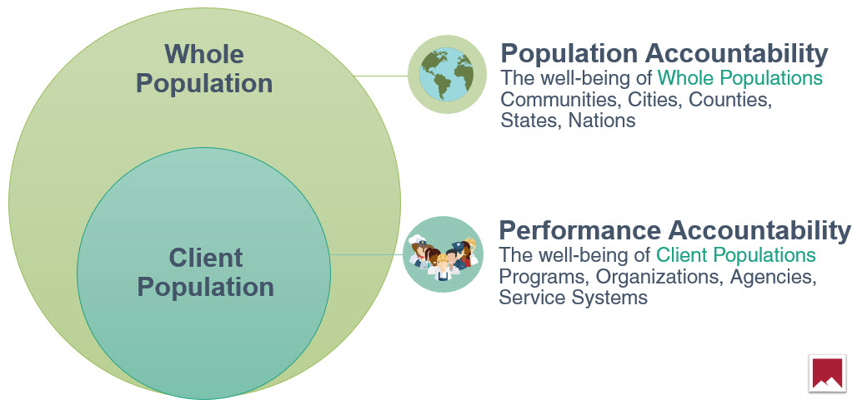
Informing Framework One: Results Based Accountability (RBA)
Community impact focuses on the conditions of well-being for children, families and communities that a group of leaders are working to improve. For example: “Residents with good jobs,” “Children ready for school,” or “A safe and clean neighborhood”. In RBA, these conditions of well-being are referred to as results or outcomes.
https://clearimpact.com/results-based-accountability/

Slide 16
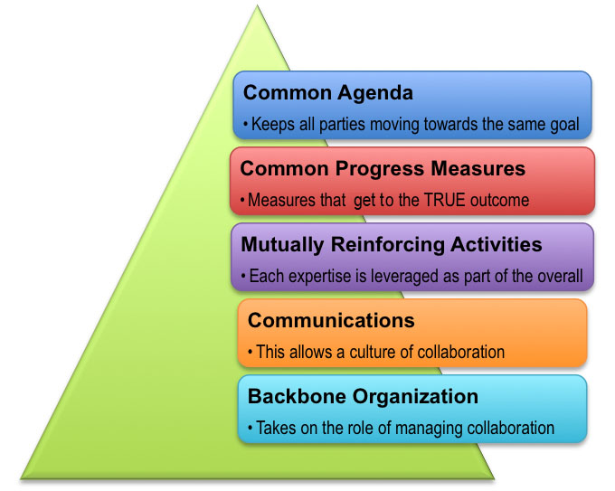
Informing Framework Two: Collective Impact (CI)
Collective Impact is a framework to tackle deeply entrenched and complex social problems. It is an innovative and structured approach to making collaboration work across government, business, philanthropy, non-profit organizations and citizens to achieve significant and lasting social change.
https://collectiveimpactforum.org/what-collective-impact

Slide 17
Importance of Data
Data should help inform what is happening in your community
data should help drive discussions to identify shared opportunities
data SHOULD MeasurE community impact

Slide 18
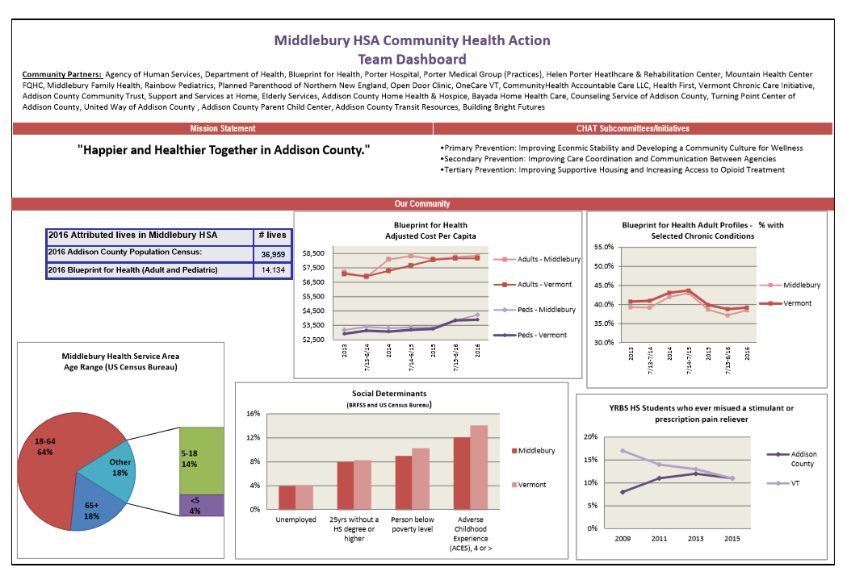
Community Dashboards (work in progress)
Intent of dashboard: longer term outcomes
Can support an ACH’s guiding principles
High level framework:
Quantitative & qualitative
Process and outcome
Benefits of building the dashboard and selecting measures for the community: shared values, common measures, etc.
Example of dashboard

Slide 19
Moving forward
Ensure cross-sector participation is embedded in structure and decision-making
Pick something to move forward with – even a small project
Learn from other Vermont ACHs
State leadership team can facilitate a working session or serve as a resource
Take it one step at a time

Slide 20
Resources
Public Health Institute: http://www.phi.org/
VT 2017 ACH Report: http://blueprintforhealth.vermont.gov/sites/bfh/files/ACH%20FINAL%20REPORT%203.25.17.pdf
Collective Impact: https://collectiveimpactforum.org/what-collective-impact
Results Based Accountability: https://clearimpact.com/results-based-accountability/
VT Blueprint for Health: Basecamp for Accountable Communities for Health: https://vthealth.basecamphq.com/ (need login)
Jim Hester’s Health Affairs article: “A Balanced Portfolio Model For Improving Health: Concept And Vermont’s Experience” (HEALTH AFFAIRS 37, NO. 4 (2018): 570–578 ©2018 )

