Slide 1
Strategy and Implementation
Using Theory of Change

Slide 2
Objectives
Understand when and why Theory of Change can be used as a tool during the ACH Strategy and Implementation process
Understand principles of participatory design required for Theory of Change
Practice creating a Theory of Change model for one of your community’s desired long term outcomes
Design a meeting agenda for your ACH to use Theory of Change

Slide 3
https://youtu.be/6zRre_gB6A4

Slide 4
What is Theory of Change?
Methodology for planning and evaluation for complex social change
Tool for explaining the process of change
A way of examining and changing conditions that requires participation and power distribution in finding solutions
Notes:
Critical theory that promotes distribution of power by including multiple perspectives and participants in finding solutions
Critical theory = examining and changing the social environment in which the problem exists (rather than just understanding or explaining it)

Slide 5
The Missing Link
Explain how and why we expect the desired change to come about and to clarify our thinking (assumptions)
Acknowledge the weaknesses/limitations in the logic and how we might address them
Can tie a wide variety of seemingly unconnected activities together

Slide 6
Purposes and Benefits
Theory of Change
Agreement on actions needed for desired change
Challenge assumptions
Mitigate against risks
Develop stakeholder ownership
Enhance accountability
Record/communicate logic
Notes:
Assists with determining actions to achieve goals

Slide 7
How does Theory of Change Fit With...
The ACH Core Element of Strategy and Implementation?
Overarching strategic framework and implementation plan that reflects its cross sector approach. Framework process involves a prevention analysis and specific commitments from healthcare, local government, business, and non-profit partners.
Collective Impact?
Mutually reinforcing activities
Results Based Accountability
Population and process accountability, performance measures, and Turn the Curve Thinking
Notes:
Theory of change...
Serves as an overarching strategic framework that both identifies commitments needed from cross-sector partners, but also articulates how the work might benefit them.
Can be used as a strategy map that organizes some of the details of a multi-faceted strategy that coordinates the mutually reinforcing activities of a broad group of stakeholders.
Is a more structured process than free brainstorming to identify what might work to address contributing factors and identifying what might “turn on the curve”.

Slide 8
Similar Models
Logic Model
Models of change
Pathways mapping
Causal pathway
Outcomes chain

Slide 9
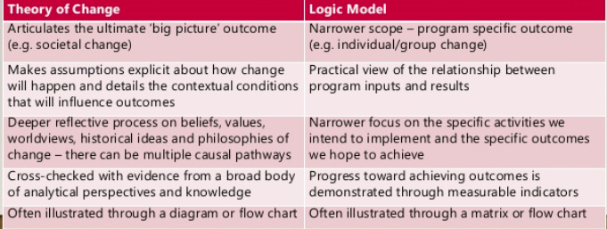
Theory of Change vs. Logic Model

Slide 11
Participatory Design
Articulate Vision of ACH
Define Desired Population Outcomes/Indicators
Build Shared Understanding of the Problem(s)
Identify and Involve Stakeholders: Primary and Secondary
Notes:
Sample Vision: That all members of our community our well housed, well nourished, and have meaning, purpose, and connection.
Sample Desired Population Outcomes for Connection:
- Develop healthy social connections throughout life to prevent disease, disability, injury and premature death and assure a high quality of life.
- Achieve equity in the opportunity to form and maintain healthy individual, family, and community-level social connections.
- Provide opportunities for safe, healthy and productive social interactions in neighborhoods and communities.
- Promote strong, healthy social connections across all life stages to support healthy development and healthy behaviors.
Sample Problem Identification:
High rate of suicide deaths among males over age 65
High Youth Depression Rate
High Social Vulnerability Index (socioeconomic, demographic, and housing/transportation)
High Hate Crime Rate
Who are the primary (directly affected) and secondary (indirectly affected) stakeholders?

Slide 12
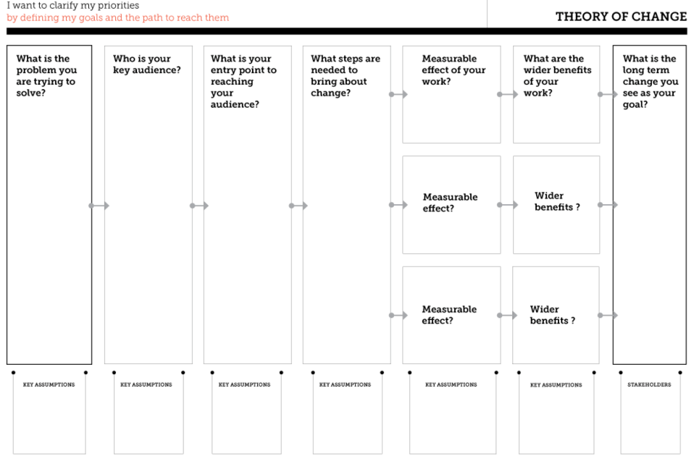
Using ToC – an Example
Males over 65, their partners, family members, care providers, (former) employers
Youth, parents, teachers, coaches, care providers
Individuals of color, LGBTQ, police/sheriff
Audience Trained as Gatekeepers
A community trained in signs and responses for suicide increases support for all ages
Suicide deaths – males over 65
Youth Depression Incidence
High Hate Crime Rate
Suicide Prevention (Training, Screening, Service Provision, reduce lethal means access)
Support During Major Life Transitions / Senior Center Outreach
Work (pre-retirement), primary care, religious groups, grocery stores, barber, gas stations, meal delivery program
Residents will have healthy social connections throughout life
Increased rate of Screening/MH Service Utilization
Earlier intervention for mental, physical, and social needs
Support visits provided at retirement, loss of partner
Greater connection to community and resources
Assumption that major life transitions are contributing factors
Assumption that these individuals were employed, in relationships, seeing a primary care provider
Assumption that individuals are connecting with at least one of the entry points
Assumption that training is enough and competency will build over time
Notes:
LONG TERM CHANGE
- Develop healthy social connections throughout life to prevent disease, disability, injury and premature death and assure a high quality of life.
- Achieve equity in the opportunity to form and maintain healthy individual, family, and community-level social connections.
- Provide opportunities for safe, healthy and productive social interactions in neighborhoods and communities.
- Promote strong, healthy social connections across all life stages to support healthy development and healthy behaviors.
PROBLEMS
High rate of suicide deaths among males over age 65
High Youth Depression Rate
High Hate Crime Rate

Slide 13
Sections
Long Term
Problems
Audience
Entry
Steps
Measurable Effect
Wider Benefits

Slide 14
Working with Stakeholders
Identifying and engaging your stakeholders
Max. group size for ideal participation (20)
Important research before gathering stakeholders
Context/problem
Existing/planned interventions
Summary of evidence for possible interventions
Do you need a simple change model or more detailed, complex one?

Slide 15
Subsequent Strategy and Planning
Create specific project management plans
Executive Summary
Project Goals
Project Scope
Milestones and Major Deliverables
Work Breakdown Structure
Budget
Staffing Plan
Risk Management Plan
Communications Plan
Monitoring and evaluation framework

Slide 16
Additional Resources
Theory of Change (www.theoryofchange.org), a collaborative project of ActKnowledge and the Aspen Institute Round- table on Community Change. This comprehensive website offers a wide array of background information, tools, and sample documents that can help grant makers and grantees get started with theory of change.
K. Kellogg Foundation (www.wkkf.org). The Logic Model Development Guide, a companion to the foundation’s Evaluation Handbook, focuses on how to develop and use a logic model.
Grantmakers for Effective Organizations (www.geofunders.org). GEO provides links to various resources on theory of change, including the INSP Theory of Change Development Tool and GEO’s own emerging organizational theory of change.
Annie E. Casey Foundation (www.aecf.org). Theory of Change: A Practical Tool for Action, Results and Learning, the foundation’s handbook for community organizations involved with its Making Connections program, is available on its website.
International Network on Strategic Philanthropy (www.insp.efc.be). The Theory of Change Development Tool and accompanying manual may be downloaded from the INSP website.

Slide 17
Break

Slide 18
Practice
Pick 1 Long Term Goal/articulate your desired long term outcomes. The entire table should agree with the intended impact.
Identify primary and secondary stakeholders
With your table, identify the conditions/problems that exist that are contrary to the desired long term outcome.
Does the group have consensus about the problems?
What assumptions are underlying the problems?

Slide 19
Practice
For each problem, identify your key audience.
Any assumptions?
Identify the entry point(s) for reaching your audience.
Any assumptions?
Identify steps needed to bring about change.
Any assumptions?
Identify measureable effects/wider benefits.
Any assumptions?

Slide 20
Facilitating a Theory of Change Meeting
How will you build an agenda for a meeting(s) that will:
Build trust among stakeholders?
Achieve broad agreement about how the problem has been identified?
Come to consensus about audience, entry, steps, etc. (sections of ToC worksheet)?
Establish timelines and plan resources for major areas of work?
How much time and what other resources will you need?

