Slide 1
Springfield’s Community Health Network

Slide 2
Study Objective
Objective
Describe the network of organizations that has emerged in each Blueprint HSA to support population and individual health, focusing on modes of collaboration and relationships between organizations
Background and Key Questions
This study is the first step towards answering key questions about the networks that are active in Blueprint communities:
What role did investment in core Community Health Teams have in seeding these larger networks?
How are the participating organizations connected to each other?
How are these relationships maintained and reinforced – how durable are they?
What characteristics do the most successful networks share?
What impact do these networks have on individual and population health?

Slide 3
Network List Development
In this Health Service Area (HSA) the methodology began with network bounding that included core health organizations as well as a wide-range of social service organization and community service organization.
The network membership list began with the 2013 study list provided by the Blueprint Project Manager, added write-ins from 2013 study responses, and additionally added organizations (if not already represented) from the Unified Community Collaborative.
Organization representative contact information was collected from Project Managers and publicly available sources such as organization websites.

Slide 4
Survey Participation
Invitations and reminders sent via Survey Monkey
Additional reminders sent directly via email (avoiding spam filters)
Invitations Sent | 142
Surveys Started | 34
Response Rate | 24%
Completed Surveys | 27
Completion Rate | 79%

Slide 5
Social Network Analysis
What?
A network graph maps interactions
Network analysis quantifies relationships
Why?
Describe a community objectively
Explore the relationships that make up a community
Look for patterns across communities
Inform planning of collaboration for community health improvement

Slide 6
Network Maps
springfield health Service Area

Slide 7
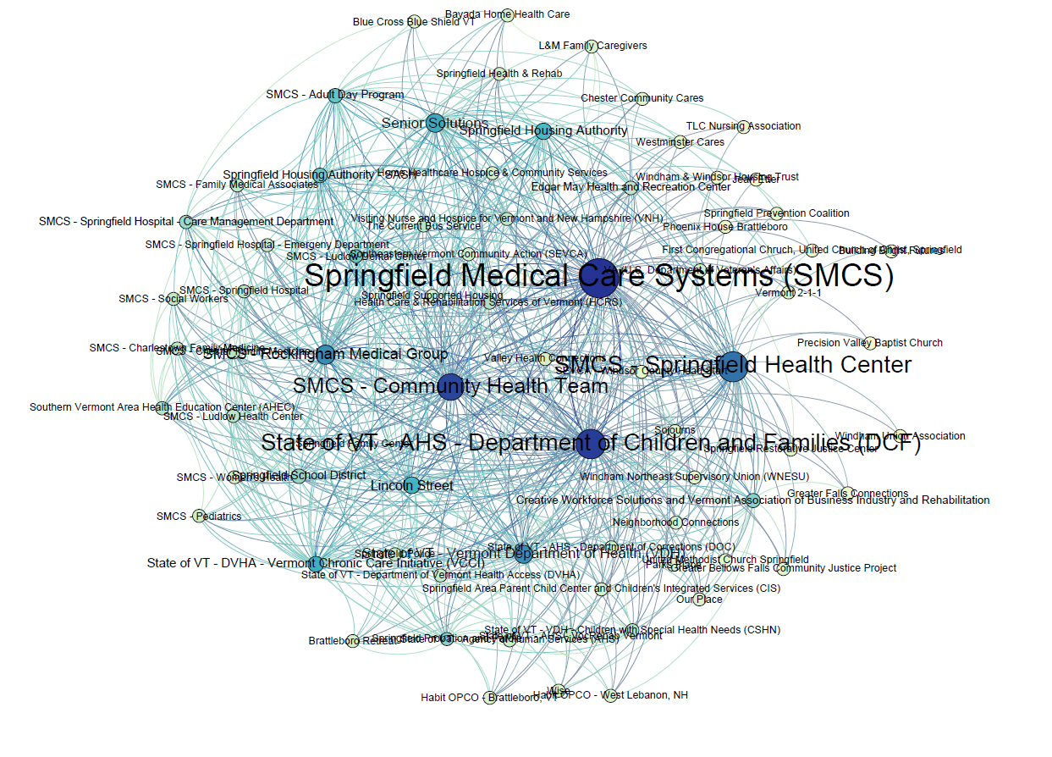
Our organizations . . .
HAVE PATIENTS/CLIENTS IN COMMON
Node color shows Degree
Node size shows Betweeness Centrality
Degree
Number of connections
Betweeness Centrality How often an organization is on the shortest path between two other organizations
Graph Density
11%

Slide 8
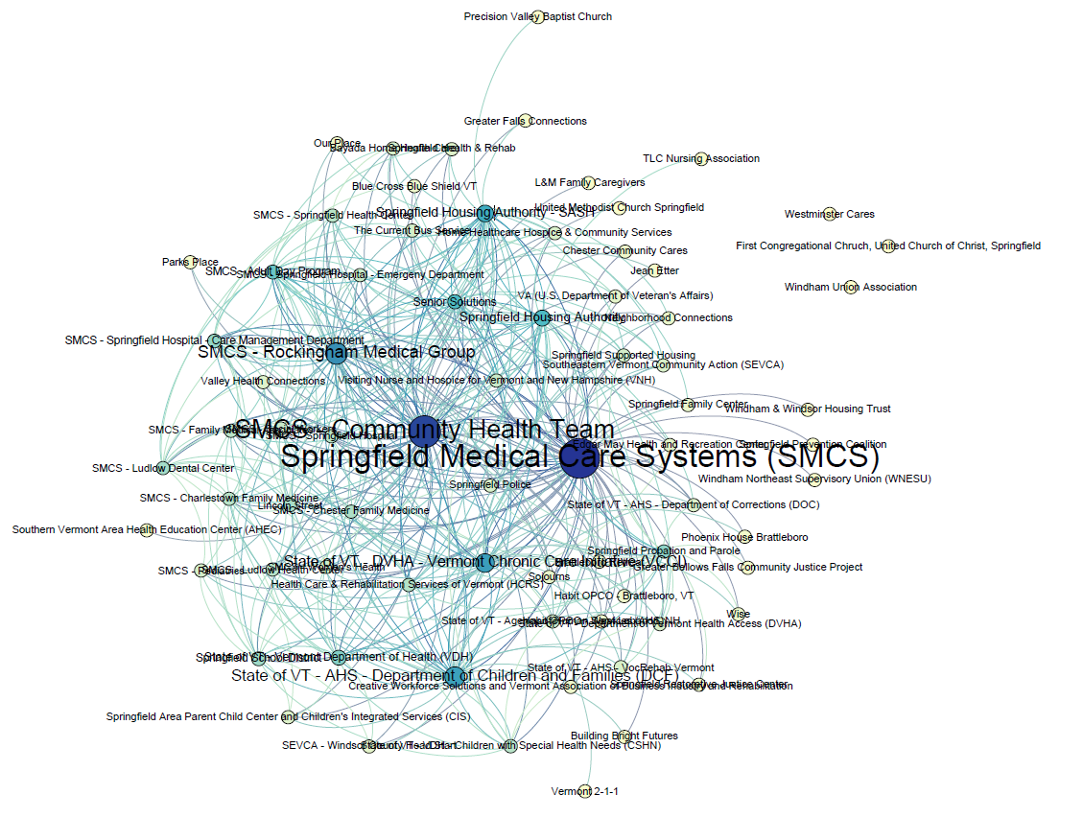
Our organizations . . .
SHARE INFORMATION ABOUT SPECIFIC PATIENTS/CLIENTS
Node color shows Degree
Node size shows Betweeness Centrality
Graph Density
12%

Slide 9
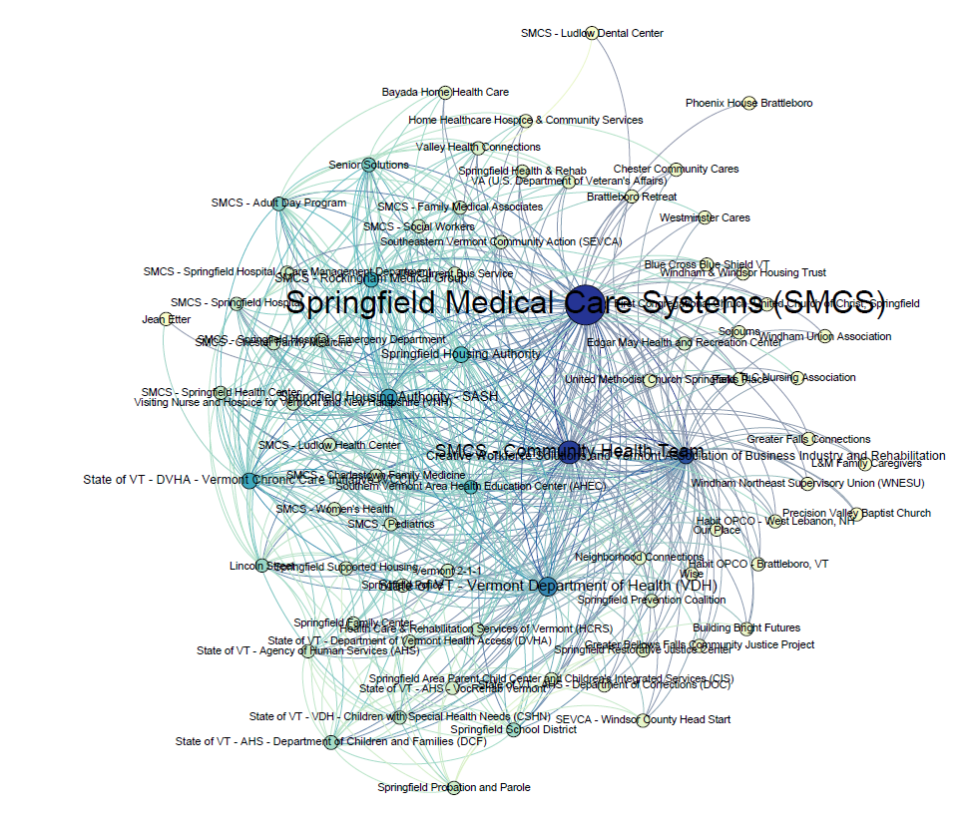
Our organizations . . .
SHARE INFORMATION ABOUT PROGRAMS, SERVICES AND/OR POLICY
Node color shows Degree
Node size shows Betweeness Centrality
Graph Density
10%

Slide 10
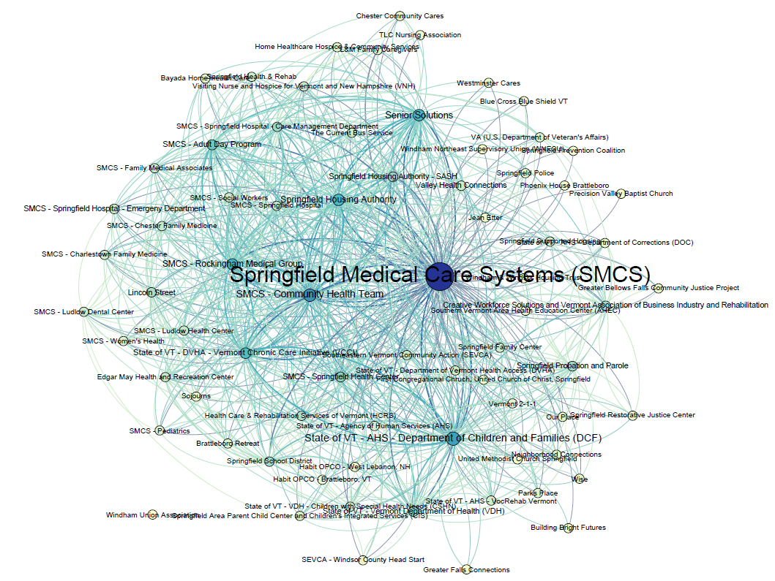
My organization SENDS REFERRALS TO this organization
My organization RECEIVES REFERRALS FROM this organization
Node color shows Degree
Node size shows Betweeness Centrality
Graph Density
14%

Slide 11
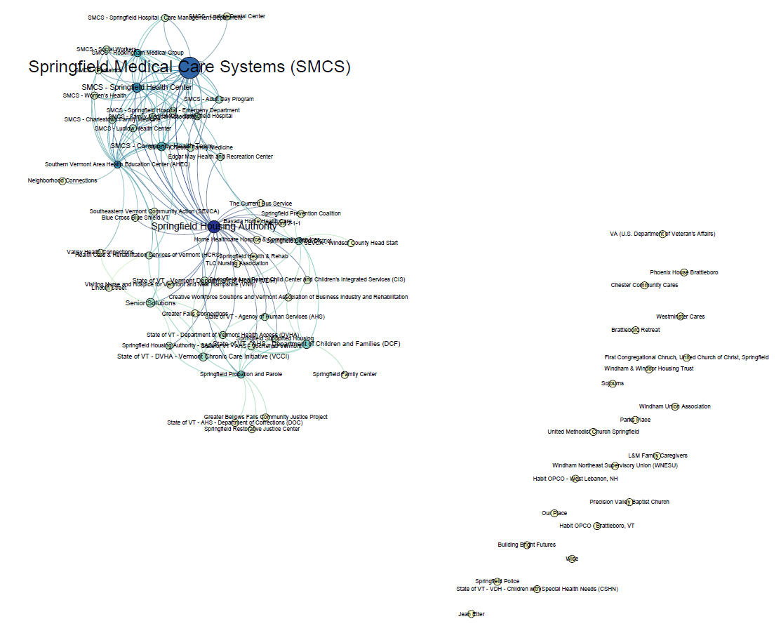
Our organizations . . .
SHARE RESOURCES
(e.g. joint funding, shared equipment, personnel or facilities)
Node color shows Degree
Node size shows Betweeness Centrality
Graph Density
3%

Slide 12
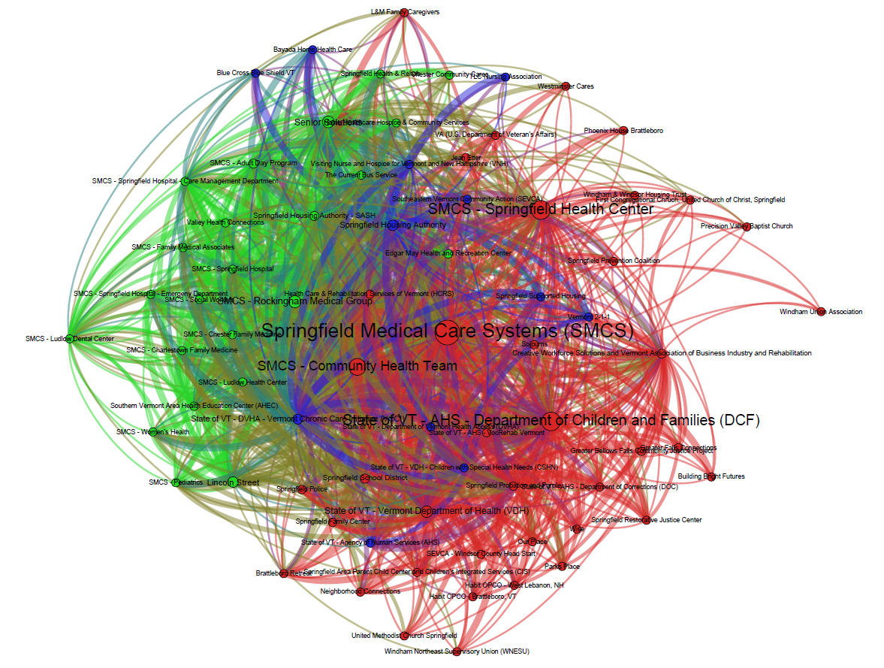
FULL NETWORK – all questions
Node color shows Network Neighborhood
Node size shows Betweeness Centrality
Blue Network Neighborhood?
Network Neighborhood
A group of organizations more likely to be connected to each other than a randomly selected organization in the network
Connectors
Medical Services
Child & Family Services
Substance Abuse Recovery
Police & Corrections

Slide 13
Springfield Area Full Network Statistics
Average Degree Average number of connections per organization | 15
Network Diameter Distance (in connections) between the two most distant organizations | 3
Graph Density Percentage of possible connections that are active | 21%
Modularity A measure of how readily the network could dissolve into separate modules | .11
Average Shortest Path Length Average shortest distance between organizations (in connections) | 1.8

Slide 14
Organization Statistics
Organizations Ranked by Betweeness Centrality
Springfield Medical Care Systems (SMCS)
State of VT - AHS - Department of Children and Families (DCF)
SMCS - Community Health Team
Senior Solutions
Creative Workforce Solutions and Vermont Association of Business Industry and Rehabilitation
Betweenness Centrality is a measure of how likely an organization is to appear on the shortest path between any two randomly selected network members.
Highest In-Degree
Springfield Medical Care Systems (SMCS) | 68
Senior Solutions | 44
State of VT - AHS - Department of Children and Families (DCF) | 41
SMCS - Community Health Team | 37
State of VT - DVHA - Vermont Chronic Care Initiative (VCCI) | 34
In-Degree represents the total number of connections directed in, towards an organization. These are connections reported by another organization, with the exception of ‘referrals from’ which would be reported by the organization itself.

Slide 15
Team Based Care
Springfield Health Service Area

Slide 16
Team Based Care

Slide 17
Observations and Questions
One network neighborhood is made up primarily of Springfield Medical Care Systems (SMCS) departments and practices. It appears this neighborhood is well integrated into the network overall, as both the parent organization SMCS and the SMCS – Community Health Team are connected but are part of a different neighborhood and are highly central to the network overall.
Springfield is one of the few HSAs that have youth and/or family services in central positions in the network. In Springfield the State of Vermont – Department of Children and Families (DCF) is the 2nd most central organization.
Both information sharing sub-networks include many organizations that are not well-integrated into the network. Each organization creating one or two new connections could transform these networks and improve the flow of communication.
Although the full Springfield network includes many organizations, a full 93% of respondents agreed that “when our organizations work together, each one has a clear role to play.” This is a jump of 28% from the previous survey.
Team Based care measures are among the highest in the state!

