Slide 1
Community Benefit Levers and Impact—Learning from Other States
Amy Clary, PhD
National Academy for State Health Policy
Vermont Accountable Communities for Health Learning Lab #5
June 24, 2019

Slide 2
Today’s Conversation
Federal community benefit landscape
State community benefit spending and strategy
Cross-sector approaches and strategy alignment

Slide 3
Legacy of ACA
Shift from volume to value
Accountable Care Organizations
Value-Based Payment
New community benefits rules

Slide 4
State Accountable Health Models Address Social Determinants
https://nashp.org/states-develop-new-approaches-to-improve-population-health-through-accountable-health-models/

Slide 5
A Brief History of Community Benefits
1956: IRS rules that hospitals can qualify for charitable tax exemption with charity care
1969: Charity care gets replaced with “community benefit” standard
Broader range of expenditures qualify
2009: IRS introduces Schedule H on Form 990 to improve community benefit reporting
2010: ACA institutes additional requirements for nonprofit hospitals
Community Health Needs Assessment

Slide 6
ACA IRS Community Benefits Requirements
To maintain their tax exemptions, non-profit hospitals must meet requirements related to:
Conduct Community Health Needs Assessments (CHNAs)
Have a written and widely available public Financial Assistance Policy
Not charge people eligible for assistance more than insured people
Determine whether people are eligible for assistance before taking extraordinary collection actions
In 2017, the IRS revoked the tax-exempt status of an unnamed hospital for failing to meet CHNA requirements.
https://www.irs.gov/charities-non-profits/charitable-organizations/requirements-for-501c3-hospitals-under-the-affordable-care-act-section-501r

Slide 7
IRS: Community Health Needs Assessments
To maintain their tax exemptions, hospitals must:
Conduct a Community Health Needs Assessment (CHNA) once every 3 years
A hospital belonging to a multi-facility system may report to the IRS as part of a group, filing with other hospitals in the system.
Adopt an implementation strategy to meet those community needs
Take into account input from people representing the community, including:
At least one public health department (state, local, regional, or tribal), and
members of medically underserved, minority, and low-income populations
https://www.irs.gov/charities-non-profits/community-health-needs-assessment-for-charitable-hospital-organizations-section-501r3

Slide 8
What does the IRS Count as Community Benefit Spending?
Community Benefit Spending (Part 1)
Subsidized health services (e.g., trauma units)
Research
Health professions education
Community health improvement services (free/reduced cost)
Financial assistance
Shortfalls from Medicaid and other programs

Slide 9
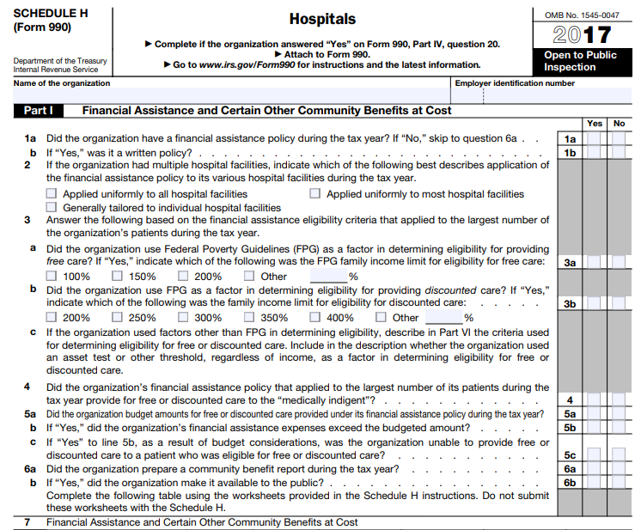
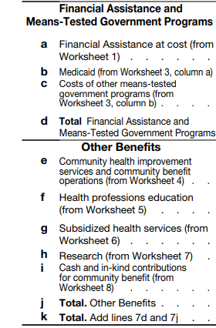
Form 990 Schedule H

Slide 10
What does the IRS Count as Community- Building Activity?
Community Building Activities (Part 2)
Housing & physical improvements
Environmental improvements
Economic development
Community support (disease surveillance, mentoring programs, violence prevention)
These activities are generally NOT included in community benefit spending unless the hospital submits additional justification
https://www.irs.gov/pub/irs-pdf/f990sh.pdf; https://journalofethics.ama-assn.org/article/how-should-nonprofit-hospitals-community-benefit-be-more-responsive-health-disparities/2019-03

Slide 11
What is NOT Required by the IRS?
A minimum amount hospitals must spend
Requirement to link spending to needs identified in the CHNA
https://www.healthaffairs.org/doi/pdf/10.1377/hlthaff.2014.1424

Slide 12
Investing in the Social Determinants of Health
IRS, Dec. 18, 2015:
“Some housing improvements and other spending on social determinants of health that meet a documented community need may qualify as community benefit for the purposes of meeting the community benefit standard.”
Health Care Without Harm/ RWJF Survey: “Having a food-related organization on the CHNA committee was strongly correlated with having a program targeting healthy food access or food insecurity.”
https://www.irs.gov/charities-non-profits/exempt-organizations-update-archive; https://noharm-uscanada.org/foodaccessCBsurvey

Slide 13
Lost Tax Revenue
In 2011, the value of the nonprofit hospital tax exemption was $24.6 billion
Cities and states both lose revenue, through property tax and income tax exemptions.
The American Hospital Association is publicizing its analysis showing that the value of hospitals’ community benefits outweighs their tax exemption
https://www.healthaffairs.org/doi/pdf/10.1377/hlthaff.2014.1424

Slide 14
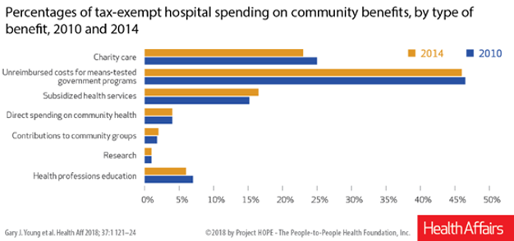
Health Affairs: Community Benefit Spending By Tax-Exempt Hospitals Changed Little After ACA
Percentages of tax-exempt hospital spending on community benefits, by type of benefit, 2010 and 2014
Charity care
Unreimbursed costs for means-tested
government programs
Subsidized health services
Direct spending on community health
Contributions to community groups
Research
Health professions education
https://www.healthaffairs.org/doi/abs/10.1377/hlthaff.2017.1028?journalCode=hlthaff
Notes:
Sara Rosenbaum: “’The shift is going from indigent care to Medicaid shortfall,’ said Sara Rosenbaum, health law and policy professor at George Washington University's Milken Institute School of Public Health. ‘If private insurance discounts don't count as community benefit, why should Medicaid discounts? I really don't see why a payment discount is a community benefit.’”
https://www.modernhealthcare.com/article/20181201/NEWS/181119965/indepth-flaws-in-hospital-community-benefit-reporting-create-knowledge-vacuum

Slide 15
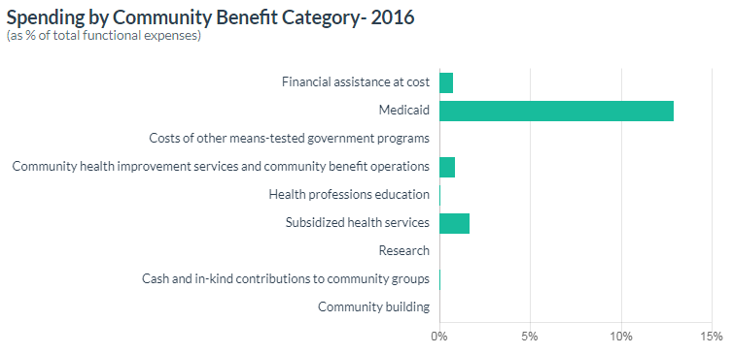
Use the RWJF Community Benefit Insight tool to compare how hospitals spend their community benefits dollars
http://www.communitybenefitinsight.org/

Slide 16
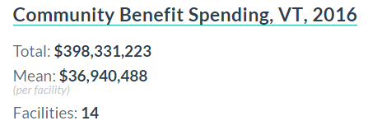
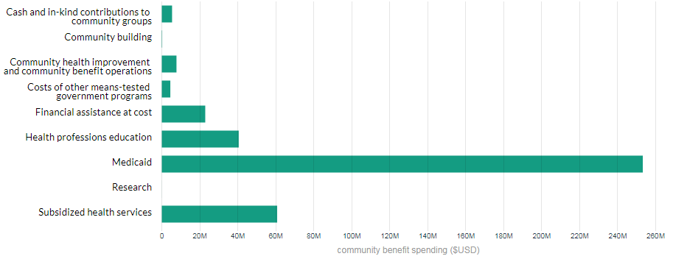
Community Benefits Insight Tool: Statewide
http://www.communitybenefitinsight.org/

Slide 17
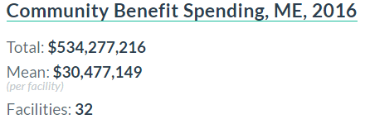
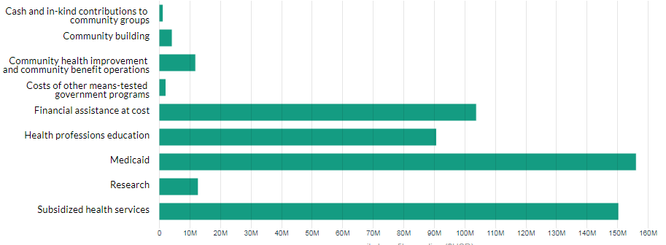
Community Benefits Insight Tool: Statewide
http://www.communitybenefitinsight.org/

Slide 18
What Can States Do?
Oregon HB 3076 requires the state to set a minimum level of community benefit for each hospital and system, and requires financial assistance to include income-based discounts.
Illinois in 2012 - Statute requires that hospitals seeking exemption provide charity care or other “health services to low-income or underserved individuals” at least equivalent to the hospital’s property tax liability
Texas in 1993 passed a charity care requirement, but the law had little impact on charity care spending on average
Some states are interested in minimum levels of required CB investment

Slide 19
What Can States Do?
Align and collaborate:
Maine shared CHNA is a collaboration between the state department of health and four health systems, informed by PHAB requirements
In New York, local health departments are strongly encouraged to develop one assessment and one plan per county by working together
Several states connect merger/CON requirements to CHNA needs (e.g., CT, MA, VT, RI)
States are partnering with hospitals, local government, and communities to align reporting and investment

Slide 20
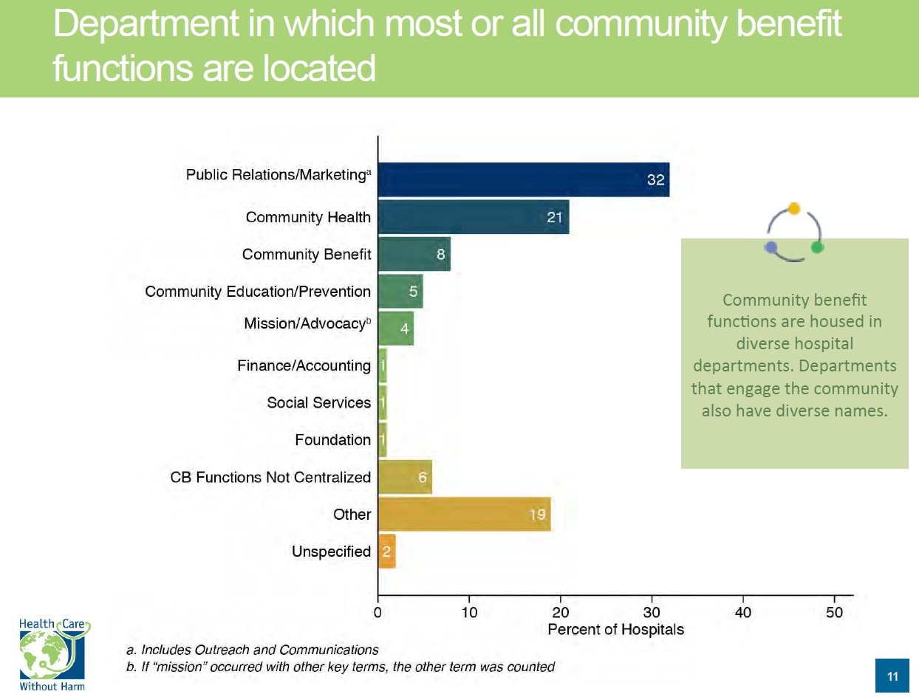
Source: Health Care Without Harm, https://noharm-uscanada.org/foodaccessCBsurvey

Slide 21
Hospital Community Benefits Comparison Table for Six New England States: VT
State CB require ment? | Minimum level of CB? | State CB reporting requirement? | State CB reporting form? | CB implementation plan/strategy required? | State Community Health Needs Assessments (CHNAs) requirement? | State income tax exemption? | State property tax exemption? | State sales tax exemption? | CB/pop. health requirements in Certificate of Need (CON)? | Enforcement levers? | How does the state use this information?
No | No | Yes. Hospital community reports must be submitted to the Green Mountain Care Board. | Hospital Community Reports (also called Hospital Report Cards). These reports require hospitals to quantify “cost shifting to private payers,” but do not include reporting of community health improvement or community building activities. | Yes. State statute requires hospitals to post descriptions of identified needs, strategic initiatives developed to address the identified needs, annual progress on implementation of the proposed initiatives, and opportunities for public participation on their websites. | Yes. Hospitals must have “a protocol for meaningful public participation” in its process for identifying and assessing community needs and integrating them with the hospital’s long-term planning. (§ 9405a) | Yes | Yes | Yes | Yes. The Green Mountain Care board will take into account whether the project helps implement the Blueprint for Health. It also considers whether it helps meets the needs of medically underserved groups and the goal of universal access to health services. (See page 10 of the VT CON Rules) | No | The Department of Health annually develops a report that lets consumers compare hospitals by quality and financial indicators (see p. 3). It also links to each hospital’s community benefit report
https://nashp.org/wp-content/uploads/2018/05/Hospital-community-benefits-chart-final-5_3_2018.pdf

Slide 22
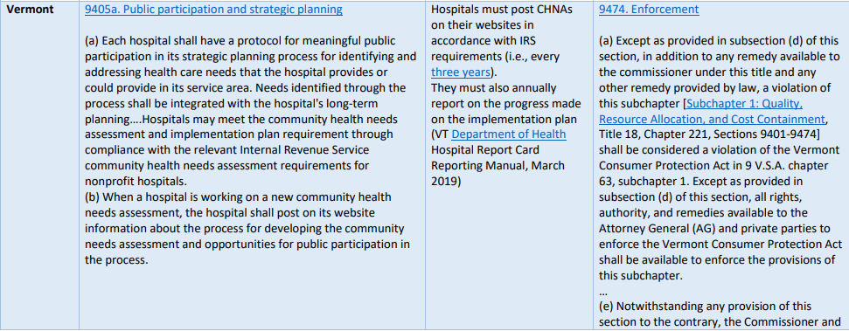
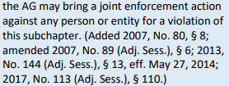
Full table at:
https://nashp.org/wp-content/uploads/2019/04/State-Requirements-or-Guidelines-for-Community-Involvement-in-Community-Health-Needs-Assessments-4-10-2019.pdf

Slide 23
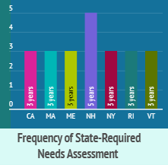
Vermont Community Health Needs Assessment (CHNA)
Community input in the CHNA process
Frequency of CHNA reporting
Enforcement of CHNA processes
https://nashp.org/how-10-states-keep-the-community-in-hospitals-community-health-needs-assessments/

Slide 24
State Community Benefits Enforcement Levers
Most common enforcement levers:
Transparency
Peer pressure
CON/merger conditions

Slide 25
Hospital/City/State Collaboration in Lawrence, MA
“Keeping the Community at the Center of Community Benefits Programs: Lessons from Lawrence, Massachusetts”
State community benefits process catalyzes cross-sector partnerships and addresses real community needs
https://nashp.org/wp-content/uploads/2018/10/Lawrence-Study.pdf

Slide 26
Lawrence, MA, case study at: https://nashp.org/wp-content/uploads/2018/10/Lawrence-Study.pdf

Slide 27
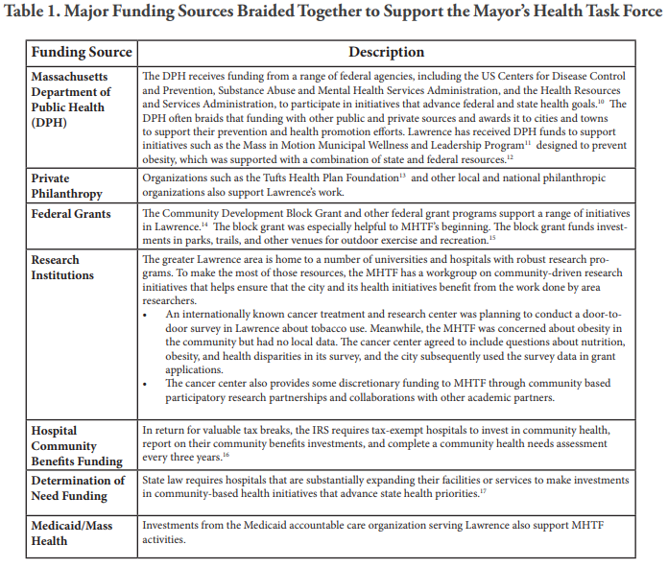
Lawrence, MA, case study at: https://nashp.org/wp-content/uploads/2018/10/Lawrence-Study.pdf

Slide 28
Rhode Island
The Rhode Island Department of Health is working to weave hospital community benefits dollars to support Health Equity Zone initiatives
Image: NASHP
https://nashp.org/lessons-from-rhode-island-how-to-effectively-blend-braid-and-use-block-grant-funds-for-public-health-and-prevention/

Slide 29
State Action Matters
A recent study found that “State adoption of multiple types of regulation was consistently associated with higher levels of hospital-provided community benefits.”
Another demonstrated that “exposure to a state-level community benefit law of any type” was associated with greater community benefit spending.

Slide 30
State levers for ensuring meaningful hospital investments include…
State reporting forms that go beyond the federal requirements
Enforcing state requirements
Licensing requirements
Taxing authority
Educating IRS
Aligning community benefits initiatives with state, local, & community health goals
Coordinating with ACOs, accountable health entities, and other upstream work
Convening stakeholders and coalitions

Slide 31
Questions and Discussion
Amy Clary
National Academy for State Health Policy
aclary@nashp.org
Many thanks to the Robert Wood Johnson Foundation and the New England States Consortium Systems Organization for their support. The views expressed here do not necessarily reflect the views of either organization.

