Slide 1
ACH DATA DASHBOARDS
ACH Learning Lab
October 8, 2018

Slide 2
Why another dashboard?

Slide 3
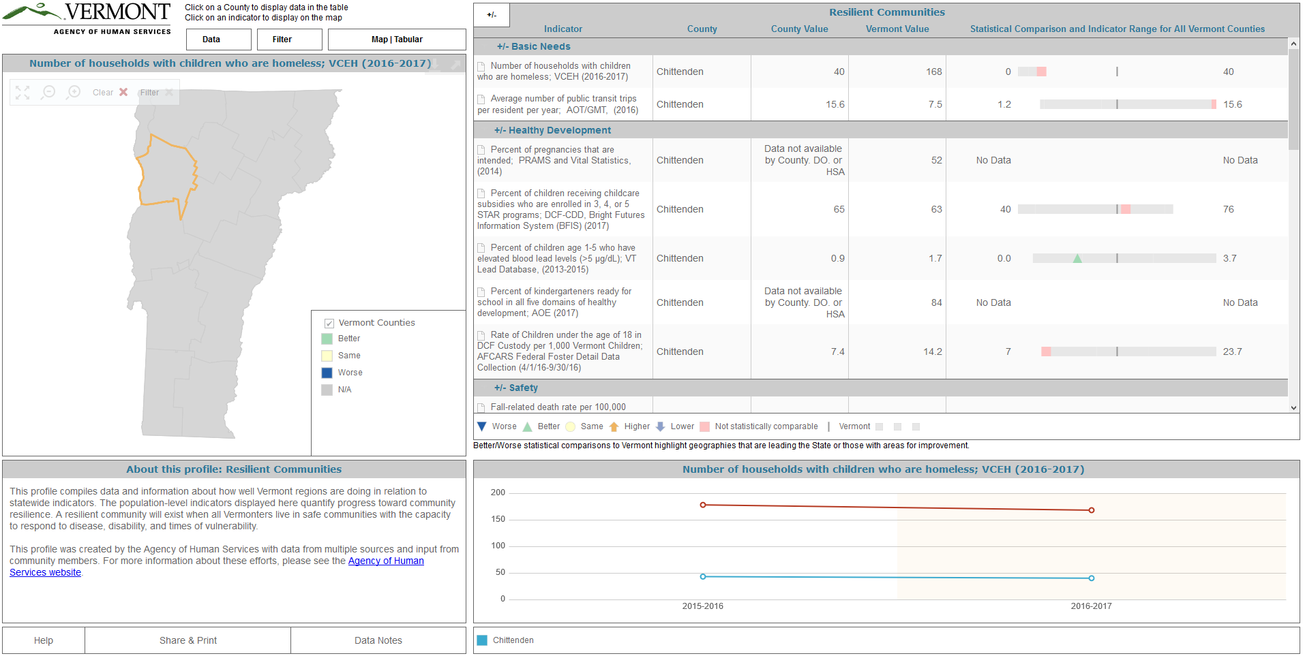
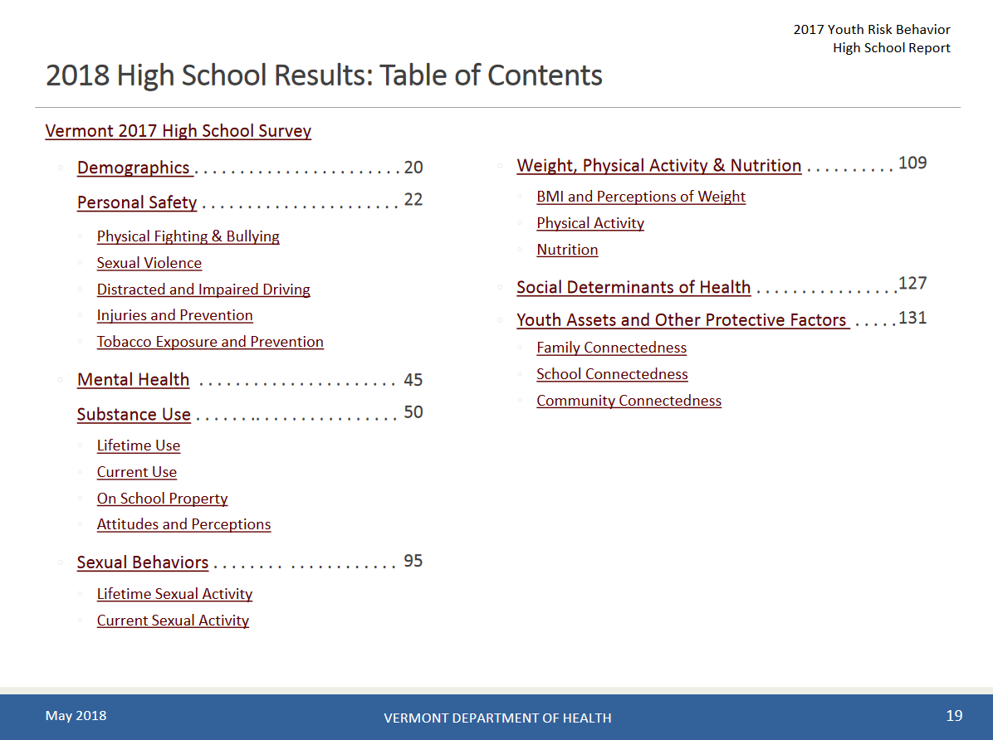
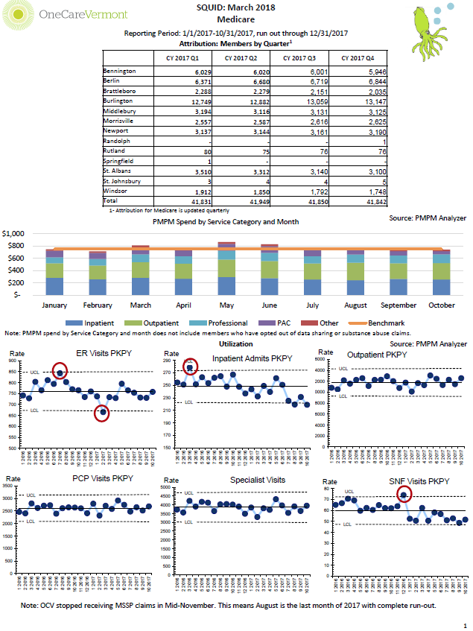
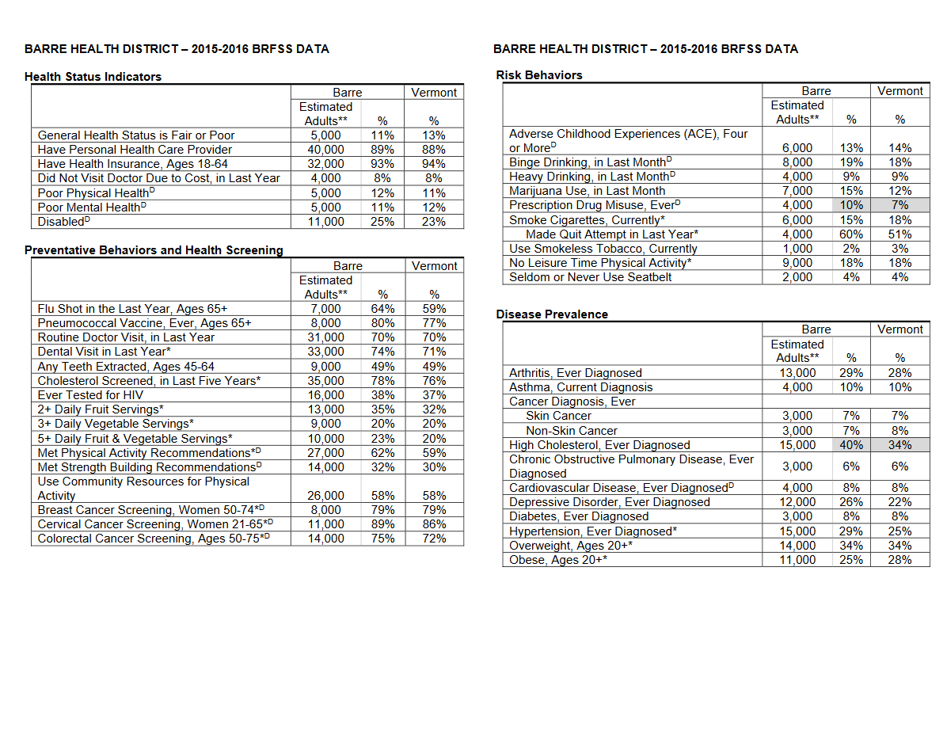
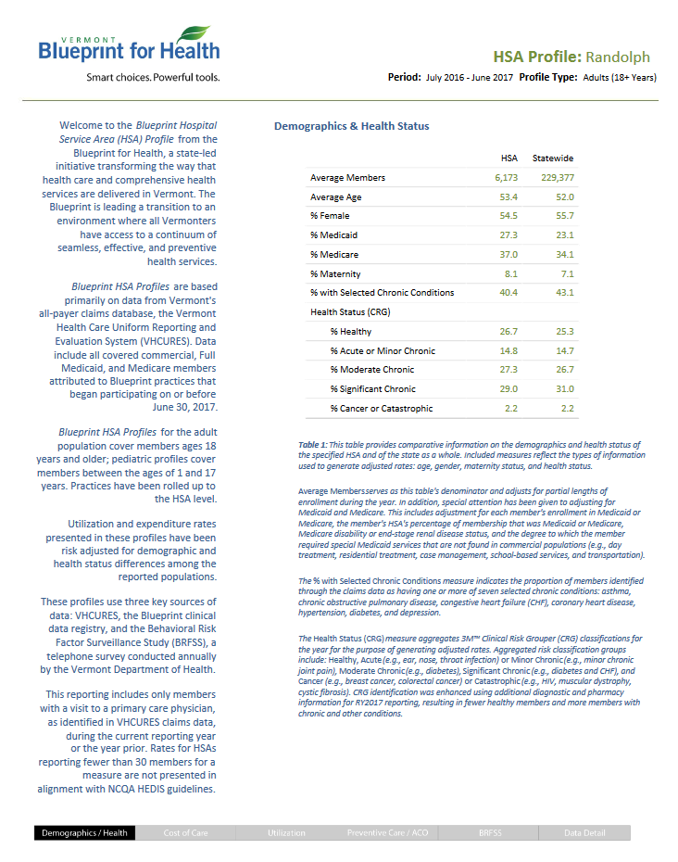
AHS PROFILES
YRBS
ONECARE
REPORTS
BRFSS
BLUEPRINT COMMUNITY PROFILES
COMMUNITY HEALTH NEEDS ASSESSMENT
+ REPORTS FROM
CENSUS
ACH Participant Orgs
Local Hospital EHR
Local Hospital Quality Dept
MOre

Slide 4
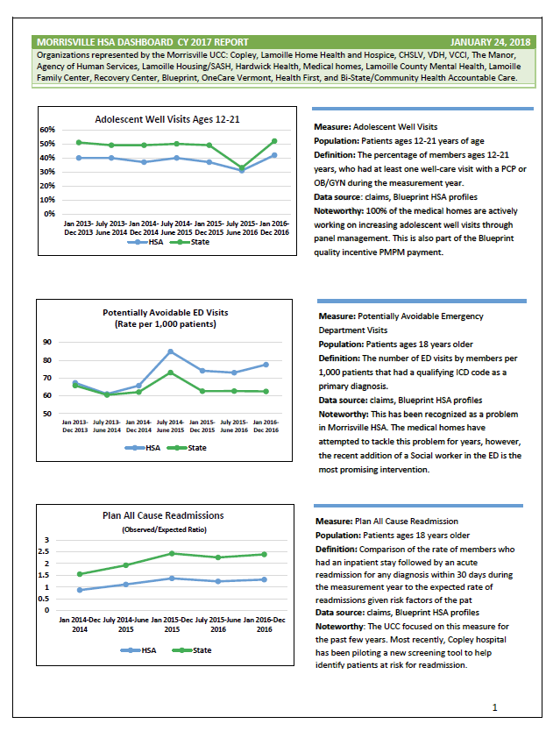

Slide 5
Getting Started
What kind of dashboard will this be?
Operational * Leadership * Analytic

Slide 6
Who is Your Audience / What Do They Need?
Ask them
What would you like to know?
What would you do if you knew this information?

Slide 7
Finding the Right Data
Your priorities / locally meaningful
Standardized if possible
Accessible
Understandable
Actionable

Slide 8
Design
“It’s beautiful if it optimizes the user’s
ability to take in the information.”

Slide 9
Case Study: Randolph

Slide 10
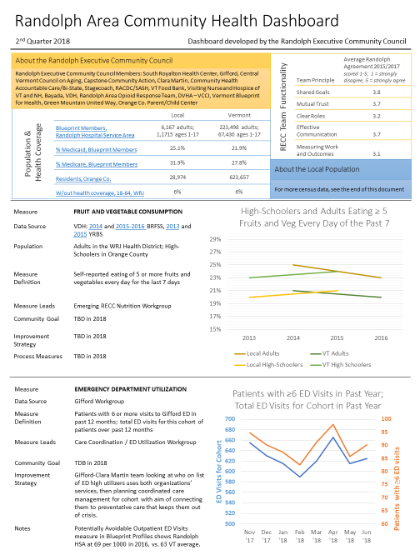

Slide 11
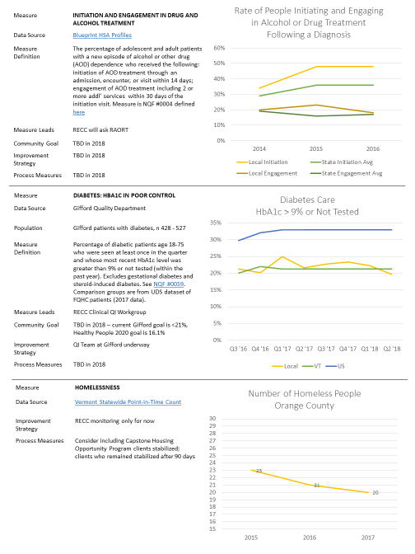

Slide 12
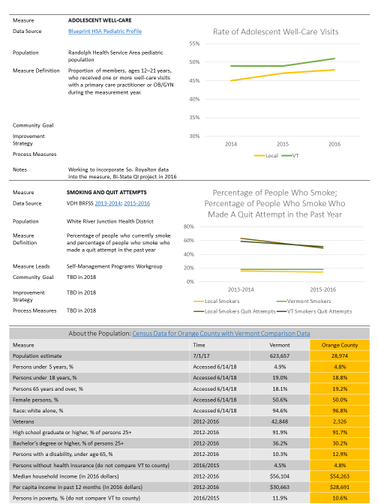

Slide 13
Case Study: Windsor

Slide 14
Hypertension Care
Hypertension Care: blood-pressure in control
Measure Definition | The percentage of patients 18 to 85 years of age who had a diagnosis of hypertension (HTN) and whose blood pressure (BP) was adequately controlled (<140/90) during the measurement quarter. Measure adapts NQF #0018 (definition here), using quarter instead of year.
Source | Local clinical data from Mt. Ascutney
Benchmark | The VT Blueprint aggregate blood pressure in control rate is 71% (using a year timeframe).
Community Goal or Process Measure | TBD
Notes | See the Vermont Hypertension Management Toolkit for Hypertension QI tools
Windsor HSA Community Collaborative | Priority Measures Dashboard | July 2018

Slide 15
Diabetes Care
Diabetes care: Diabetes in poor control
Measure Definition | The percentage of patients 18-75 years of age with diabetes (type 1 and type 2) whose most recent HbA1c level during the measurement quarter was greater than 9.0% (poor control) or was missing a result, or if an HbA1c test was not done during the measurement quarter. Measure adapts NQF #0059 (definition here) using quarter instead of year.
Source | Local clinical data from Mt. Ascutney and White River Family Practice
Benchmark | The VT Blueprint aggregate A1c in poor control rate was 12% in 2016 (using a year timeframe).
Community Goal or Process Measure | TBD
Notes | Dr. Levin is leading a quality improvement project at Mt. Ascutney, aiming to help patients with Diabetes improve their health.
Windsor HSA Community Collaborative | Priority Measures Dashboard | July 2018

Slide 16
Substance Use Disorder Treatment
Measure Definition | The percentage of adolescent and adult patients with a new episode of alcohol or other drug (AOD) dependence who received the following: initiation of AOD treatment through an admission, encounter, or visit within 14 days; engagement of AOD treatment including 2 or more addl’ services within 30 days of the initiation visit. Measure is NQF #0004 defined here. Rates have been adjusted for Medication Assisted Treatment and Behavioral Health Residential Treatment.
Source | Vermont Department of Health data
Notes | Project underway building SBIRT into Emergency Department workflow through CHT staff, making referrals to treatment as needed.
Spoke Medication Assisted Treatment Resources, May 2018
MDs prescribing | 11
MDs prescribing to ≥ 10 patients | 5
Staff FTE Hired | 3
Medicaid Beneficiaries | 224
Windsor HSA Community Collaborative | Priority Measures Dashboard | July 2018

Slide 17
3-4-50 Prevention Work
3-4-50 Prevention
Measure Definition | Percentage of adults and high schoolers who report eating 3 or more vegetables each day of the last 7. Interaction with local prevention and healthy living initiatives will also be reported.
Source | VDH’s YRBS for Windsor Co., BRFSS for White River Jct.
Notes | Shifted from fruit and vegetable consumption to vegetable consumption based on available YRBS calculations.
Windsor HSA Community Collaborative | Priority Measures Dashboard | July 2018

