Slide 1
Windsor’s Community Health Network
Windsor Health service area
Fy2015

Slide 2
Objective
Objective
Describe the network of organizations that has emerged in each Blueprint HSA to support population and individual health, focusing on modes of collaboration and relationships between organizations
Background and Key Questions
This study is the first step towards answering key questions about the networks that are active in Blueprint communities:
What role did investment in core Community Health Teams have in seeding these larger networks?
How are the participating organizations connected to each other?
How are these relationships maintained and reinforced – how durable are they?
What characteristics do the most successful networks share?
What impact do these networks have on individual and population health?

Slide 3
Social Network Analysis
To address the key questions of this study, we use social network analysis.
What is social network analysis?
Social network analysis quantifies communities and in particular the relationships between actors in a community.
What is a network graph?
A network graph shows connections between individuals or, in this case, organizations.
What can social network analysis tell me?
Social network analysis can help describe a community and explore the relationships that make up that community. Once these relationships are visible, we can start to look for patterns, as well as changes over time, in how the most effective networks coalesce and how they create change. Our observations of network graphs and understanding of community network data will inform our planning of collaboration for community health improvement.

Slide 4
Network List Development
In this Health Service Area (HSA) the methodology began with network bounding that included core health organizations as well as a wide-range of social service organization and community service organization.
The network membership list began with the 2013 study list provided by the Blueprint Project Manager, added write-ins from 2013 study responses, and additionally added organizations (if not already represented) from the Unified Community Collaborative.
Organization representative contact information was collected from Project Managers and publicly available sources such as organization websites.

Slide 5
Survey Participation
In this health service area, invitations and reminders were sent via Survey Monkey.
Invitations Sent | 80
Surveys Started | 40
Response Rate | 50%
Completed Surveys | 31
Completion Rate | 78%

Slide 6
Participating Organizations
Aging in Hartland
Bayada Home Health Care & Hospice
Cedar Hill
Change the World Kids
Granite United Way
Habit OPCO – West Lebanon
Health Care & Rehabilitation Services of Vermont (HCRS)
HCRS – Children’s Integrated Services
Historic Homes of Runnemede
Mt. Ascutney Hospital and Health Center (MAHHC)
MAHHC – Case Management
MAHHC – Emergency Department
MAHHC – Blueprint Community Health Team
MAHHC – Pediatrics
MAHHC – Volunteers in Action
MAHHC – Windsor Connection Resource Center
MAHHC – Mt. Ascutney Physicians Practice
MAHHC – Mount Ascutney Prevention Partnership (MAPP)
MAHHC – Ottauquechee Health Center
Neighbors Helping Neighbors
Ottauquechee Health Foundation
Reading and Albert Bridge School
Senior Solutions
Southeastern Vermont Community Action (SEVCA)
Southern Vermont Area Health Education Center (AHEC)
Springfield Area Parent Child Center
Springfield Housing Authority
Springfield Housing Authority – SASH
Springfield Supportive Housing
State of VT – Agency of Human Services (AHS)
State of VT – AHS – Department of Children and Families (DCF)
State of VT – AHS – DCF – Economic Services Division
State of VT – AHS – Department of Corrections (DOC)
State of VT – AHS – Department of Disabilities, Aging and Independent Living (DAIL)
State of VT – AHS – Department of Vermont Health Access (DVHA)
State of VT – AHS – DVHA – Vermont Chronic Care Initiative (VCCI)
State of VT – Vermont Department of Health (VDH)
Thompson Senior Center
Turning Point Recovery Center
U.S. Department of Veterans Affairs (VA) – White River Junction VA Medical Center
Vermont Adult Learning
Vermont Psychiatric Survivors
Visiting Nurse and Hospice for Vermont and New Hampshire (VNH)
Windham & Windsor Housing Trust
Windsor County Court Diversion
Windsor Food Shelf
Windsor Jr./Sr. High School
Windsor Police Department
Windsor School District
Woodstock Union Middle School
MAHHC – Spoke*
SASH*
Windsor Central Supervisory Union*
Bold indicates response to the survey
* Indicates respondent write-in

Slide 7
Network Maps
Windsor health service Area

Slide 8
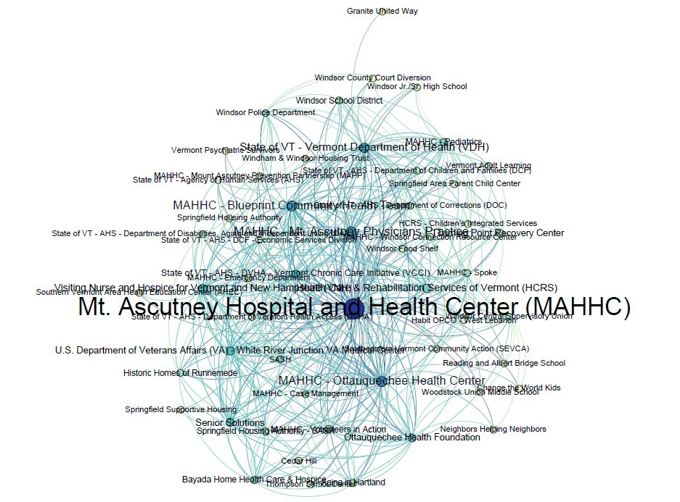
Our organizations . . .
HAVE PATIENTS/CLIENTS IN COMMON
Node color shows Degree
Node size shows Betweeness Centrality

Slide 9
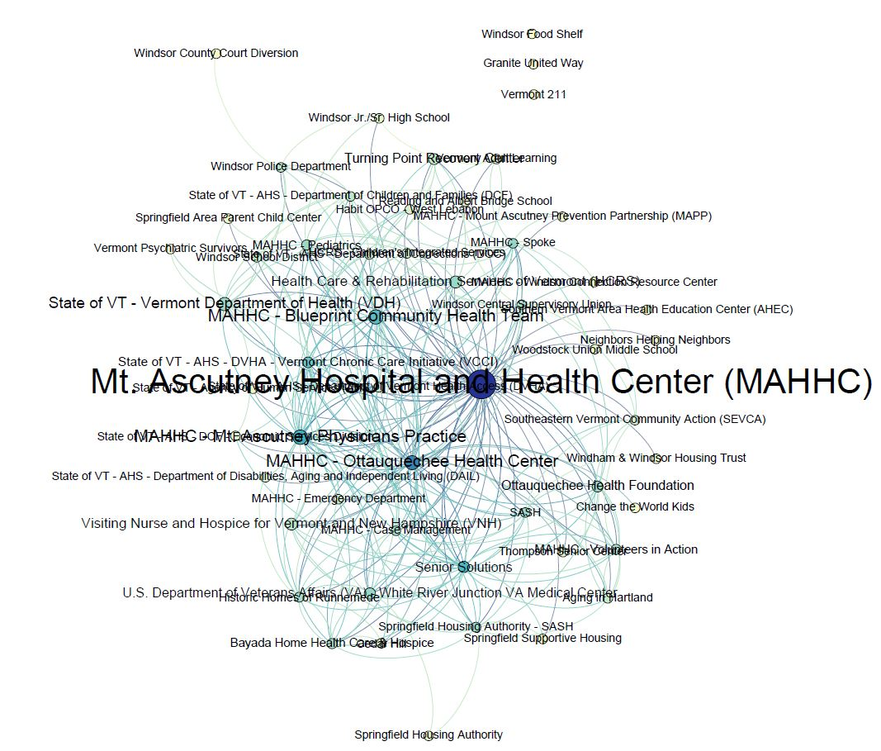
Our organizations . . .
SHARE INFORMATION ABOUT SPECIFIC PATIENTS/CLIENTS
Node color shows Degree
Node size shows Betweeness Centrality

Slide 10
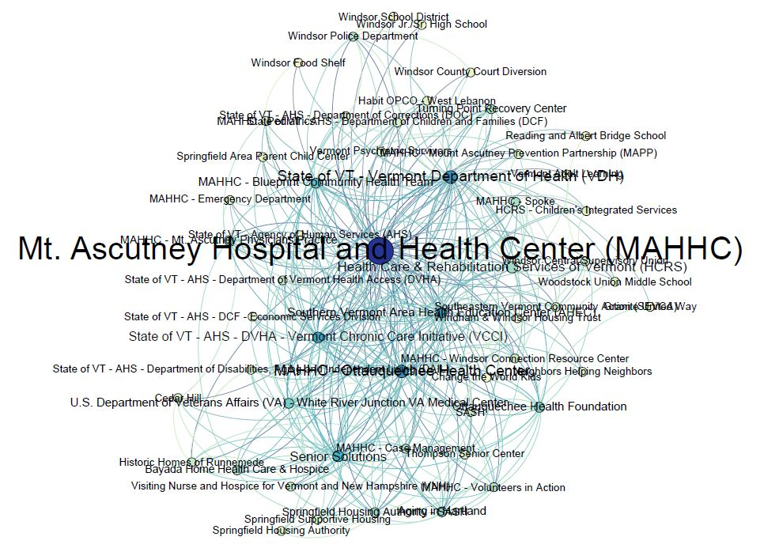
Our organizations . . .
SHARE INFORMATION ABOUT PROGRAMS, SERVICES AND/OR POLICY
Node color shows Degree
Node size shows Betweeness Centrality

Slide 11
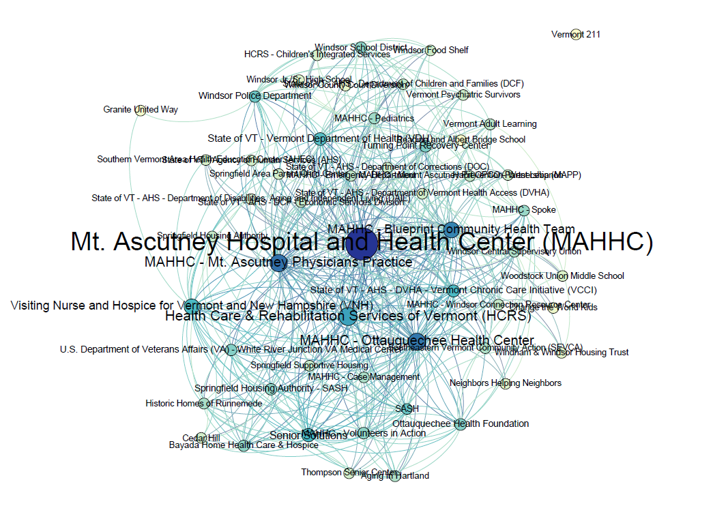
My organization SENDS REFERRALS TO this organization
My organization RECEIVES REFERRALS FROM this organization
Node color shows Degree
Node size shows Betweeness Centrality

Slide 12
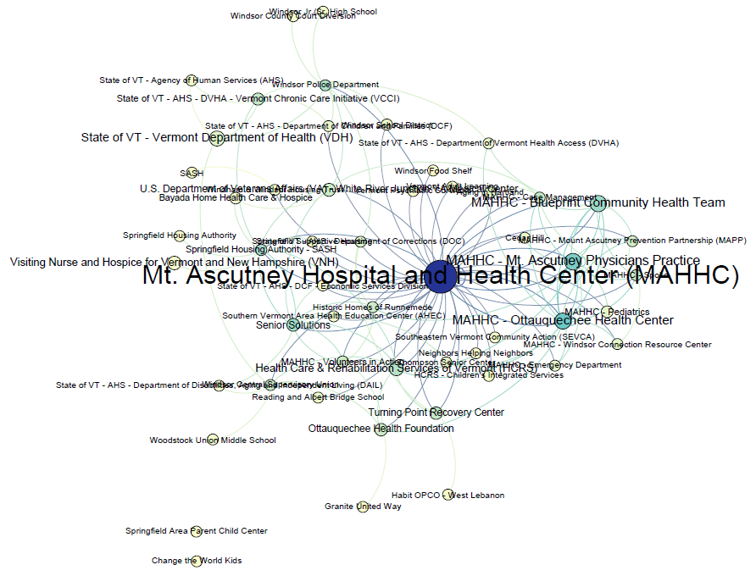
Our organizations . . .
SHARE RESOURCES
(e.g. joint funding, shared equipment, personnel or facilities)
Node color shows Degree
Node size shows Betweeness Centrality

Slide 13
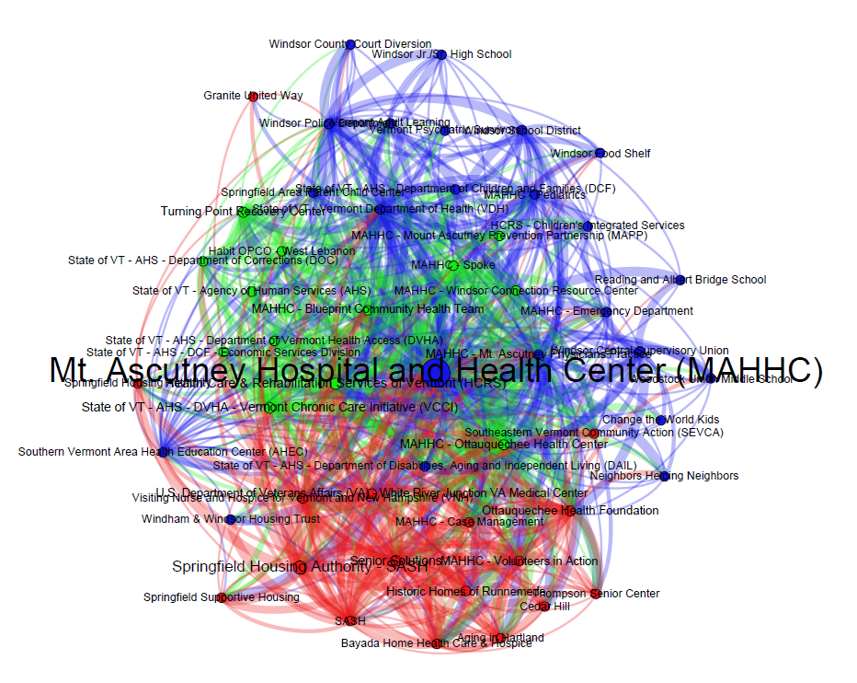
FULL NETWORK – all questions
Node color shows Network Neighborhood
Node size shows Betweeness Centrality
Mt. Ascutney Hospital and Health Center is the most central organization in the full network, and is alone at the center to a degree not seen in most health service areas.
Network neighborhoods appear to be formed around populations served. Elder care organizations and housing are clustered in the red network neighborhood. Child and family services, including schools, are clustered in the blue network neighborhood. The green network neighborhood is a mix of state services and substance abuse recovery services.

Slide 14
Full Network Statistics
Avg. Degree | 13.852
Avg. Weighted Degree | 34.63
Network Diameter | 3
Graph Density | 0.271
Modularity | 0.169
Avg. Clustering Coefficient | 0.586
Avg. Path Length | 1.761

Slide 15
Organization Statistics
Organizations Ranked by Betweeness Centrality
Mt. Ascutney Hospital and Health Center (MAHHC)
Springfield Housing Authority - SASH
Health Care & Rehabilitation Services of Vermont (HCRS)
State of VT - AHS - DVHA - Vermont Chronic Care Initiative (VCCI)
Senior Solutions
Betweenness Centrality is a measure of how likely an organization is to appear on the shortest path between any two randomly selected network members.
Highest In-Degree
Mt. Ascutney Hospital and Health Center (MAHHC) | 14
Health Care & Rehabilitation Services of Vermont (HCRS) | 8
MAHHC - Case Management | 7
MAHHC - Ottauquechee Health Center | 5
MAHHC - Blueprint Community Health Team | 5
In-Degree represents the total number of connections directed in, towards an organization. These are connections reported by another organization, with the exception of ‘referrals from’ which would be reported by the organization itself.

Slide 16
Team Based Care
Windsor health service Area

Slide 17
Team Based Care
Team-based care measures are more strongly positive than in last year’s study. Agreement that the community demonstrated the given qualities of an effective team increased 6-10% across all areas except Effective Communication, where agreement decreased 4%. In every measure, Windsor outperforms the state average.

Slide 18
Community Observations
Write-in organizations included: other practitioners private, Green Mtn RSVP, local clergy, Woodstock Food Shelf (x3), Bridgewater Sustainable Earth Foundation, Barnard Helping Hands, Reading Food Shelf, Neighbors Helping Neighbors, HIV/HCV Resource Center, Good Beginnings, Aging in Hartland, Tyson Ladies Aide Group, Killington Elementary, Killington Seniors, Good Neighbor/Red Logan Clinic, Dartmouth Hitchcock Community Health, Alice Peck Day Community Health, Kings Daughters, Zack’s Place, Reading Food Shelf, Prosper Ladies Group, Woodstock Rotary
“Many issues are identified, such as housing and dental – repeat over and over sometimes without resolution”
“Mt Ascutney’s Blueprint Team is excellent – very focused on person centered care and looks for collaborations to prevent duplication.”
“Every day members of our Community Health Team – which is the MAHHC CHT strive to learn more about and share information with each and every resource that we can in order to have the knowledge base to help each individual to meet their needs and health goals.”
“The Blueprint work has improved information sharing and the opportunities to collaborate in Southern Vermont.”
“We appreciate our partners and are exploring ways with intra-agency care management to better integrate services on behalf of our patients.”
“Building nicely!”
“School nurses are no longer in an effective role with the Blueprint . . . had more presence with Child Protection Teams.”
“I think we do a great job through PATCH to communicate.”
“I think the PATCH meeting is such a great tool and informative asset to the needs of our communities.”
“Many families are getting duplicated services because families/communication lacking information another agency already in the home.”
“Hard to rank MAHHC as separate entities as listed in the survey as we are small and work together so closely.”

Slide 19
Closing Thoughts
Cause for celebration
A strong, cohesive team
Clear leadership AND broad inclusion
And more . . .
Opportunities for improvement
Measuring success
What else?

