Slide 1
Randolph’s Community Health Network
Randolph Health service Area
July 2015

Slide 2
Objective
Objective
Describe the network of organizations that has emerged in each Blueprint HSA to support population and individual health, focusing on modes of collaboration and relationships between organizations
Background and Key Questions
This study is the first step towards answering key questions about the networks that are active in Blueprint communities:
What role did investment in core Community Health Teams have in seeding these larger networks?
How are the participating organizations connected to each other?
How are these relationships maintained and reinforced – how durable are they?
What characteristics do the most successful networks share?
What impact do these networks have on individual and population health?

Slide 3
Social Network Analysis
To address the key questions of this study, we use social network analysis.
What is social network analysis?
Social network analysis quantifies communities and in particular the relationships between actors in a community.
What is a network graph?
A network graph shows connections between individuals or, in this case, organizations.
What can social network analysis tell me?
Social network analysis can help describe a community and explore the relationships that make up that community. Once these relationships are visible, we can start to look for patterns, as well as changes over time, in how the most effective networks coalesce and how they create change. Our observations of network graphs and understanding of community network data will inform our planning of collaboration for community health improvement.

Slide 4
Core Network List Development
In this Health Service Area (HSA) the network membership list was limited to a core set of health and social services organizations, similar to the organizations participating in the area’s Unified Community Collaborative.

Slide 5
Survey Participation
In this health service area, invitations and reminders were sent via Survey Monkey and additional reminders were sent directly via email to reach potential respondents whose email clients may have labeled the Survey Monkey invitation as spam. The direct email approach used a link to the survey, which could be forwarded and used by multiple respondents including respondents not on the original list of invitees.
Invitations Sent | 29
Surveys Started | 9
Response Rate | 31%
Completed Surveys | 8
Completion Rate | 89%

Slide 6
Network Maps
Randolph Health Service Area

Slide 7
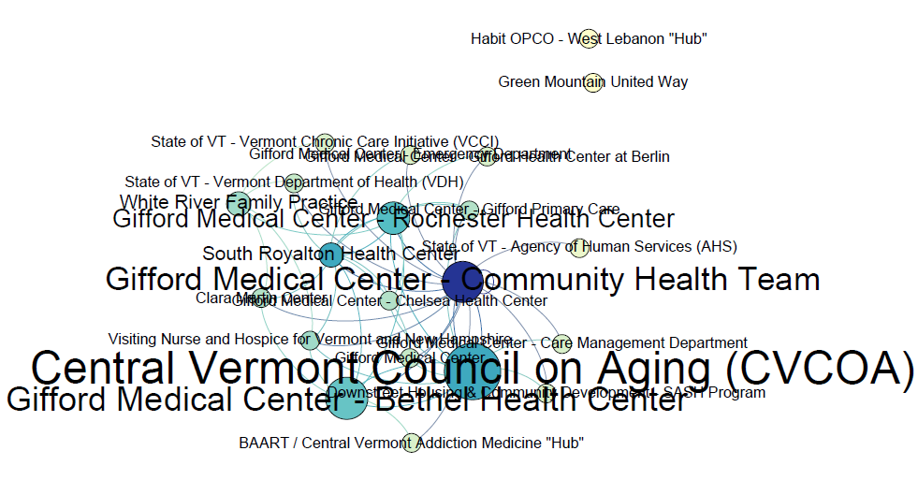
Our organizations . . .
HAVE PATIENTS/CLIENTS IN COMMON
Node color shows Degree
Node size shows Betweeness Centrality

Slide 8
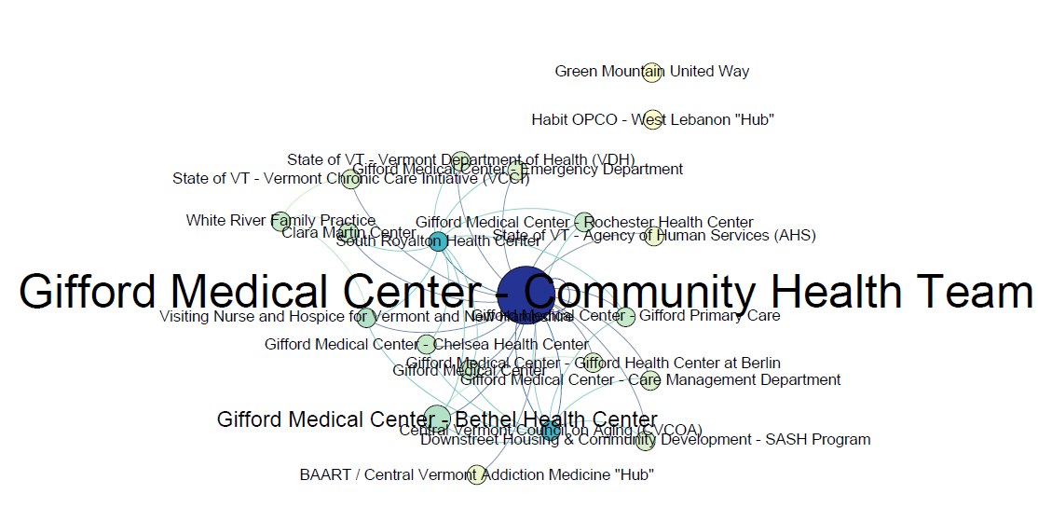
Our organizations . . .
SHARE INFORMATION ABOUT SPECIFIC PATIENTS/CLIENTS
Node color shows Degree
Node size shows Betweeness Centrality

Slide 9
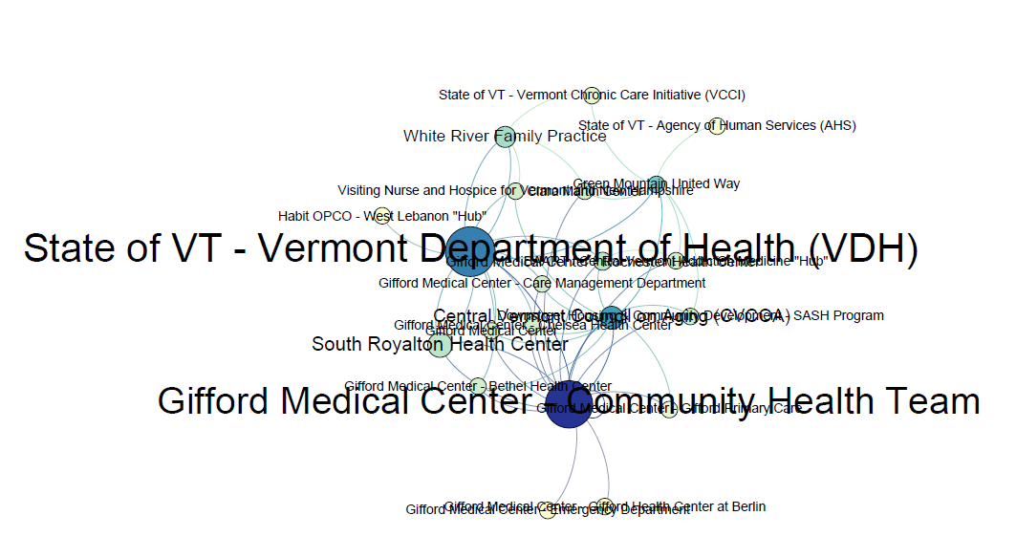
Our organizations . . .
SHARE INFORMATION ABOUT PROGRAMS, SERVICES AND/OR POLICY
Node color shows Degree
Node size shows Betweeness Centrality

Slide 10
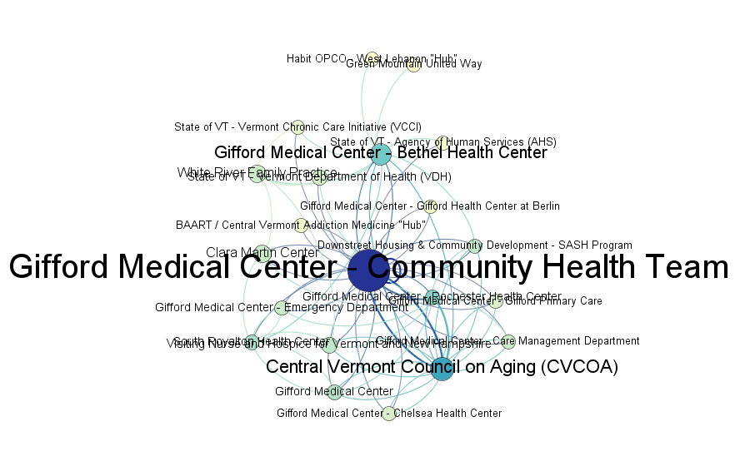
My organization SENDS REFERRALS TO this organization
My organization RECEIVES REFERRALS FROM this organization
Node color shows Degree
Node size shows Betweeness Centrality

Slide 11
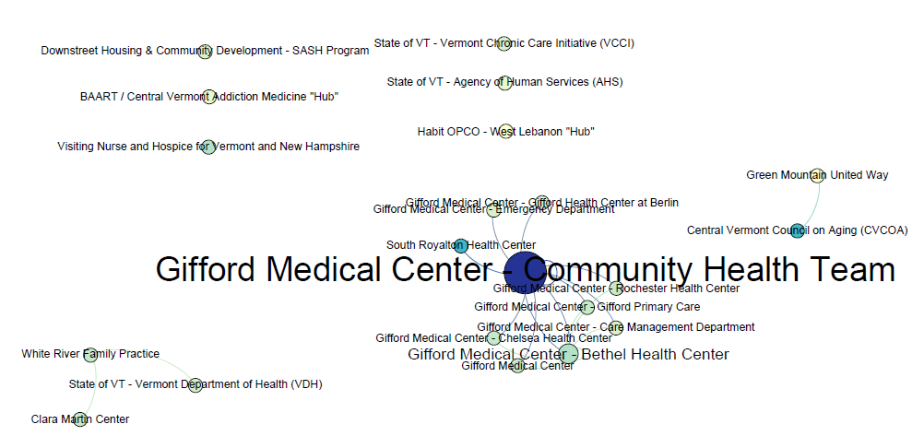
Our organizations . . .
SHARE RESOURCES
(e.g. joint funding, shared equipment, personnel or facilities)
Node color shows Degree
Node size shows Betweeness Centrality

Slide 12
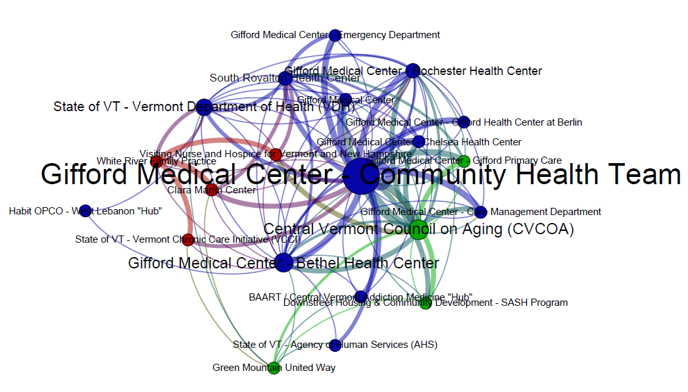
FULL NETWORK – all questions
Node color shows Network Neighborhood
Node size shows Betweeness Centrality

Slide 13
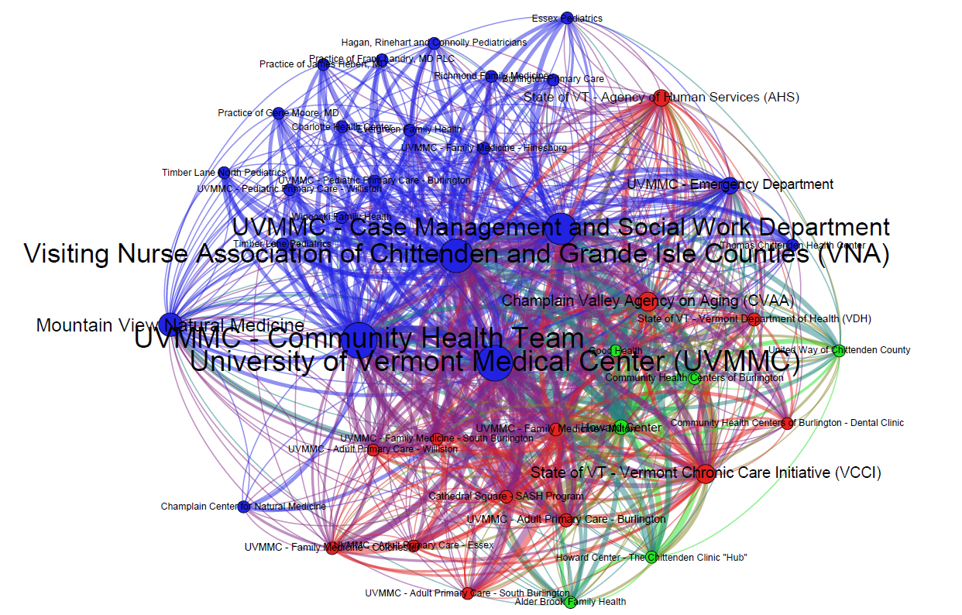
COMPARISON 1 – BURLINGTON NETWORK
FULL NETWORK – all questions
Node color shows Network Neighborhood
Node size shows Betweeness Centrality

Slide 14
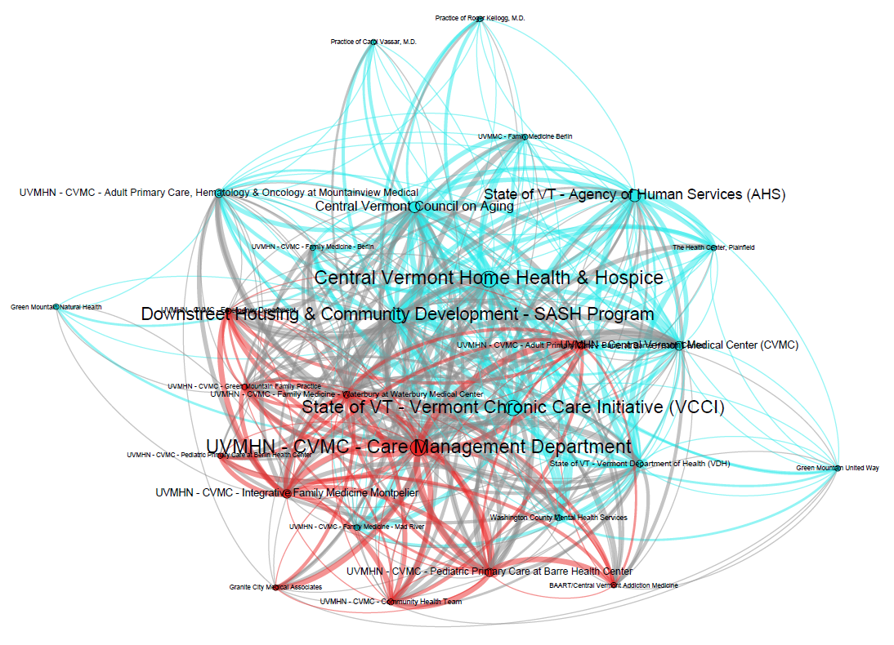
COMPARISON 2 – BARRE NETWORK
FULL NETWORK – all questions
Node color shows Network Neighborhood
Node size shows Betweeness Centrality

Slide 15
Network Statistics
 | Common Patients | Info – Patients | Info – Programs | Resources | Referrals | Full Network
Avg. Degree | 2.381 | 1.905 | 2.238 | 0.952 | 3.381 | 5.286
Avg. Weighted Degree | 2.381 | 1.905 | 2.238 | 0.952 | 3.619 | 11.095
Network Diameter | 4 | 2 | 5 | 2 | 5 | 3
Graph Density | 0.119 | 0.119 | 0.112 | 0.048 | 0.119 | 0.264
Modularity | 0.133 | 0.133 | 0.216 | 0.304 | 0.105 | 0.103
Avg. Clustering Coefficient | 0.329 | 0.311 | 0.247 | 0.249 | 0.413 | 0.586
Avg. Path Length | 1.67 | 1.188 | 1.775 | 1.143 | 2.091 | 1.828

Slide 16
Organization Statistics
Organizations Ranked by Betweeness Centrality
Gifford Medical Center - Community Health Team
Central Vermont Council on Aging (CVCOA)
Gifford Medical Center - Bethel Health Center
State of VT - Vermont Department of Health (VDH)
Gifford Medical Center - Rochester Health Center
Betweenness Centrality is a measure of how likely an organization is to appear on the shortest path between any two randomly selected network members.
Highest In-Degree
Gifford Medical Center - Community Health Team | 15
Central Vermont Council on Aging (CVCOA) | 10
Visiting Nurse and Hospice for Vermont and New Hampshire | 7
Gifford Medical Center - Bethel Health Center | 6
State of VT - Vermont Department of Health (VDH) | 6
In-Degree represents the total number of connections directed in, towards an organization. These are connections reported by another organization, with the exception of ‘referrals from’ which would be reported by the organization itself.

Slide 17
Team Based Care
Randolph health service Area

Slide 18
Team Based Care

Slide 19
Observations and Questions
Is it possible the Randolph HSA’s network neighborhoods are influenced by geography? One small network neighborhood includes White River Family Practice and Visiting Nurse and Hospice for Vermont and New Hampshire (organizations with headquarters further east) while another network neighborhood includes Central Vermont Council on Aging and Downstreet Housing and Community Development – SASH Program (organizations with headquarters further west).
This network is more modular than other networks in the same wave of the research, meaning it could more easily divide into two or more fully separate network.
Of the Team Based Care measures, the two that changed from the previous survey were Shared Goals (up 17%) and Measurement (down 13%, to only 13% agreeing that organizations measure the work they do together and its outcomes). Measurement should be a target for improvement, building on the goals already established.

