Slide 1



Laural Ruggles MBA, MPH
VP Marketing and Community Health Improvement

Slide 2

Bridging for Health is fostering connections among multisector stakeholders to rebalance and align investments in health.
Collaboration & Collective Impact
Innovations in Financing
Health & Health Equity
https://ghpc.gsu.edu/project/bridging-for-health/

Slide 3
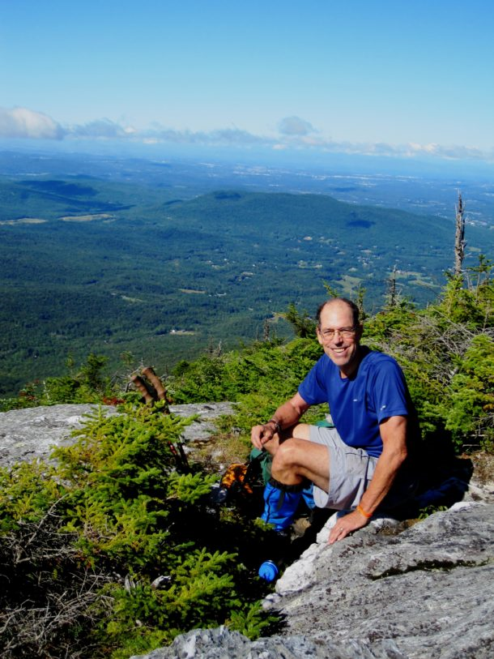
Jim Hester
Photo from VT Digger and Jocelyn Hebert

Slide 4
Bridging for Health Timeline
2017
Site Visit
September 2017
Bridging For Health
October 2017
CAHC
November 2017
Bridging For Health
Stewardship Module
December 2017
Conduct financial systems mapping
Develop short list of potential strategies
Financing Module
Financial systems mapping
Narrow strategies and financing innovations
CAHC
Strategy Module
Formative Assessment
Cross-Site Webinar
Select strategy and financing innovation
Design/ prototype the population health intervention and financing mechanism
Site Visit
  CAHC
    Form Bridging for Health Work Group
    ID potential strategies
Bridging for Health provides ongoing TA including evaluation support and access to national experts

Slide 5



Bridging for Health Timeline
2018
January 2018
CAHC working group
February 2018
Bridging for Health Peer Site Visit
March - May 2018
CAHC
Finalize prototype and secure approval from full collaborative
June - December 2018
CAHC presents prototype at the peer site visit in Atlanta
CAHC
Test prototype
Assess innovation and make necessary adjustments
Bridging for Health provides ongoing TA including evaluation support and access to national experts

Slide 6
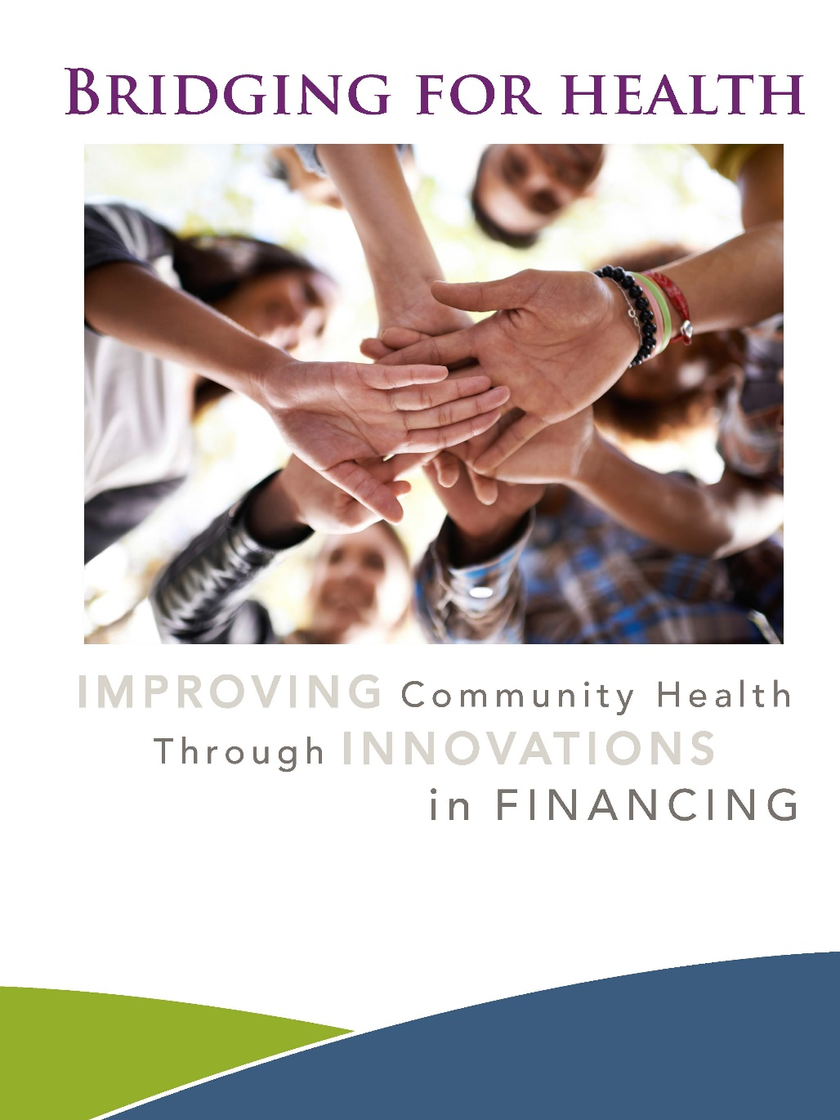
Move thinking upstream
Look at the money
Explore the financing vehicles
Build stewardship
Look for intersections
Invest together

Slide 7
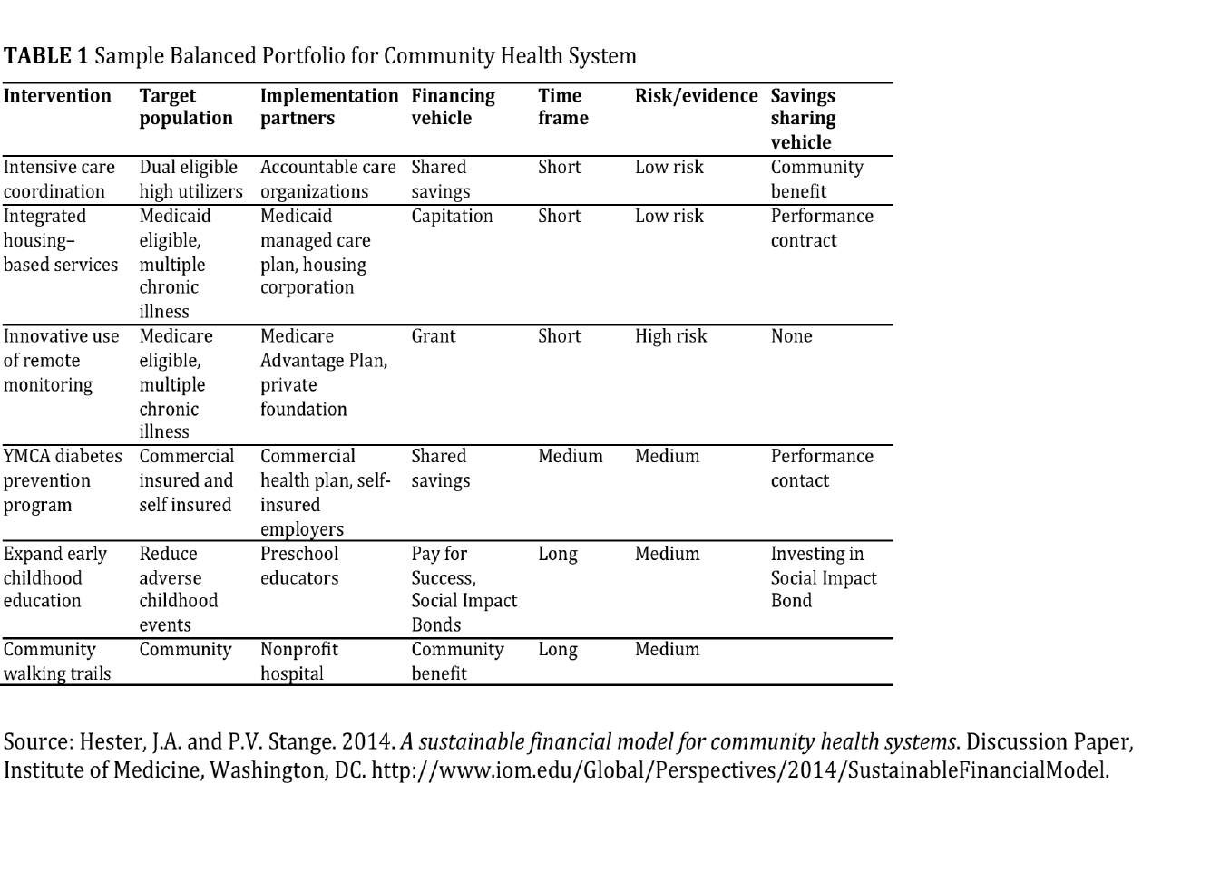

14

Slide 8
Move thinking upstream
Look at the money
Explore the financing vehicles
Build stewardship
Look for intersections
Invest together

Slide 9

Stewardship Defined
Stewardship teams are groups of well-positioned leaders who are willing and able to take responsibility for improving their system of health broadly, and who lead together on behalf of that system, not just their own organizations. They look different in every community. Participants often include leaders
from health care, public health, business, insurers, philanthropy and nonprofits, social services, transportation, housing, and education. ~ ReThink Health

Slide 10


Learn a new language to find common ground.
CDFI
Accredited Investors
A1c

Slide 11
“Prosperous communities are healthy communities.”
~Jim Kisch, President, Passumpsic Savings Bank

Slide 12
The single strongest predictor of health is socio-economic status.
https://unnaturalcauses.org

Slide 13

Success looks like…
Small Business Growth Explodes in NEK
Prosperity Funds Hits $25 Million Mark
All NEK Prosper Members Commit Money to Prosperity Fund
NEK Poverty Rate Lowest in Vermont
Initial Prosperity Fund Businesses Give Back; Reinvest in the Fund
Median Household Income in the NEK Jumps for First Time
Prosperity Fund Expands Walkable Communities Across the NEK
NEK Warming Shelter Closes Due to Lack of Need

Slide 14
Janice Shade
The Initiative for Local Capital

Slide 15
Theory of Change
We believe that, if we engage investment from citizen investors and institutions to finance business/projects
this will enhance the region's health and prosperity
by providing for a social return to the community
and a financial return to investors

Slide 16
The Challenge
Democratic access for investors
  Open to anyone who loves the NEK
  No restrictions on level of wealth or place of residence
Not just another charitable loan fund
  Allows equity/equity-like investments
Easy and inexpensive to set up and manage
  Works within current state/federal regulations (Investment Company Act of 1940)

Slide 17
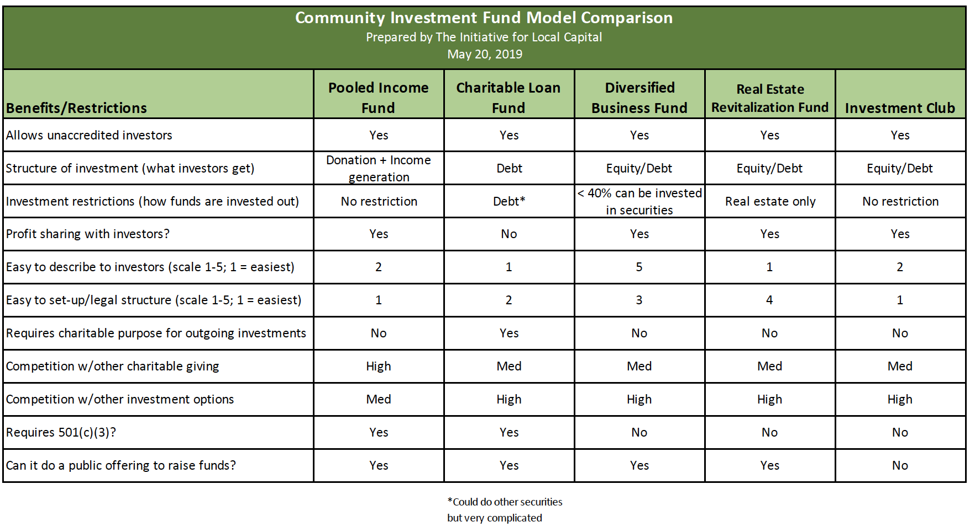
The Options

Slide 18
Pooled Income Fund
Mutual Fund without the regulatory burden
Community-scale fund
Allows any number of investors of any level of wealth to participate
Can make equity investments in local businesses (along with any other kind of investments)
Income from invested pool of funds is distributed to contributor/beneficiary for life
Notes:
Adopt Key Messages for investor and entrepreneur audiences
May need slightly different messages for local investor segment

Slide 19
How It Works
Initial investment in form of a contribution to a qualified non-profit organization
  A portion is tax deductible in year of contribution
Money from all investors is pooled and invested according to the Fund’s guidelines
Income from invested pool of funds is distributed to contributor/beneficiaries for life
Upon death, remainder goes to the non-profit organization
Notes:
Adopt Key Messages for investor and entrepreneur audiences
May need slightly different messages for local investor segment

Slide 20
Investor Pyramid:
How will we achieve
$2 million?
Roughly 90% of investors contribute 25% of Fund
Begin to create a target list of potential high-level donors.
35 @ $5,000
200 @ $1,000
300 @ $500
3 @ $100,000
6 @ $50,000
25 @ $10,000
1 @ $250k
Notes:
Get a better idea of what the numbers will be in order to finalize pyramid, marketing, outreach and recognition.

Slide 21
Keys to Success
Dedicated Cross-Sector Team of Community Prosperity Architects
  Healthcare – Economic Development - Financial – Philanthropic - Local Gov’t
Established & Experienced Fund Management Candidate
  Nonprofit 501(c)3
    Preferably a Community Development Financial Institution
    Financial/Technical Assistance Provider
  NEK example: Northern Community Investment Corp (NCIC)
Shared Love of Place

