Slide 1
ACH Learning Lab #5 – Sustainable Financing
June 24, 2019

Slide 2
9:00 am - Welcome
9:15 am – The Core Element of Sustainable Financing: What are you trying to pay for and what are your options? Erin Just, Blueprint for Health
10:00 am –Innovative Financing for Community Health. Laural Ruggles, NEK Prosper; Janice Shade, The Initiative for Local Capital
10:45 am – Break
11:00 am – Community Benefit Levers and Impact – Learning from Other States. Amy Clary, National Academy for State Health Policy
12:00 pm - Morrisville Case Example– How Copley Hospital Invested $10,000 to meet Transportation Needs. Elise McKenna, Morrisville; Corey Perpall, Copley Hospital
12:30 pm – Lunch
1:15 pm –Sustainable Funding Pilot – Leveraging the ACO and ACH Framework. Jenney Samuelson, Department of Vermont Health Access; Sara Barry, OneCare Vermont; Laural Ruggles, NEK Prosper
2:00 pm– Break
2:15 pm – Private/Public Partnerships Panel. The Vermont Community Fund, The Tarrant Foundation, Local Capital
3:00 pm - Close

Slide 3
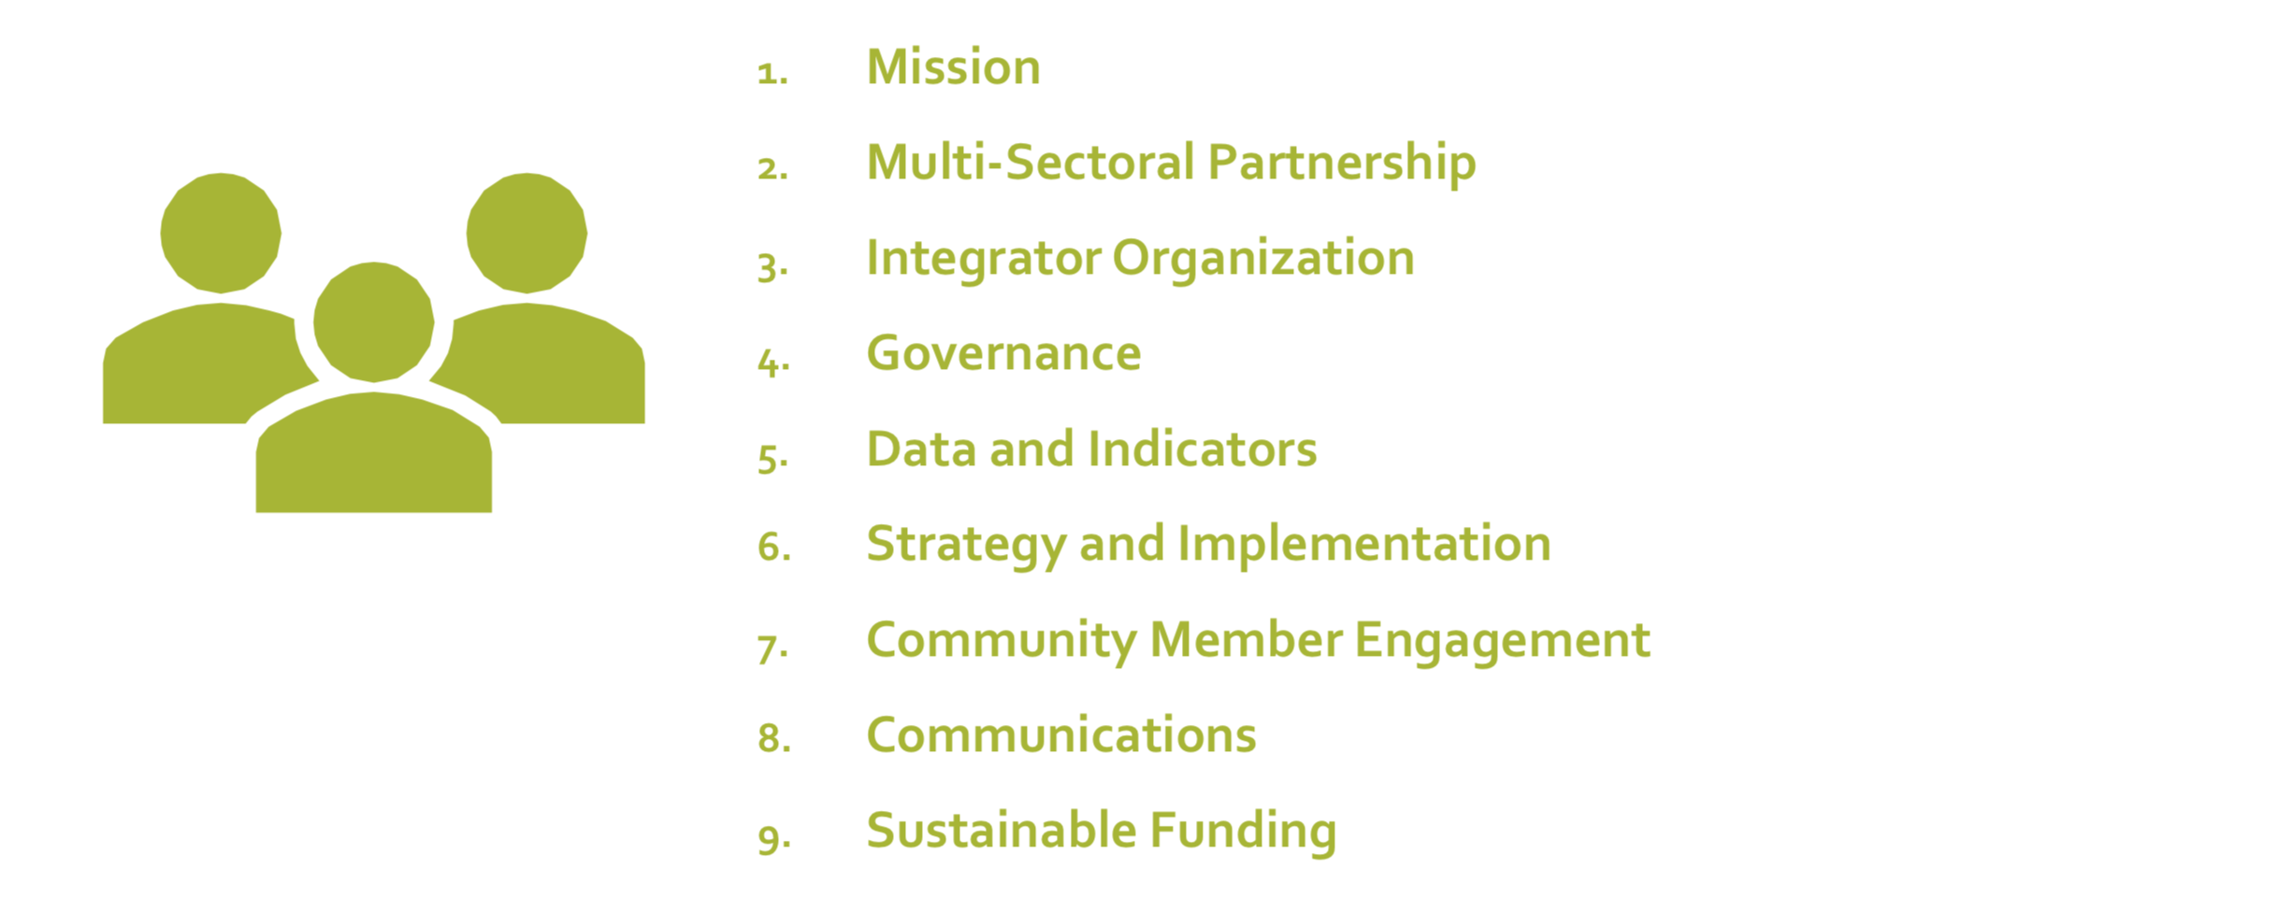
ACH Core Elements

Slide 4
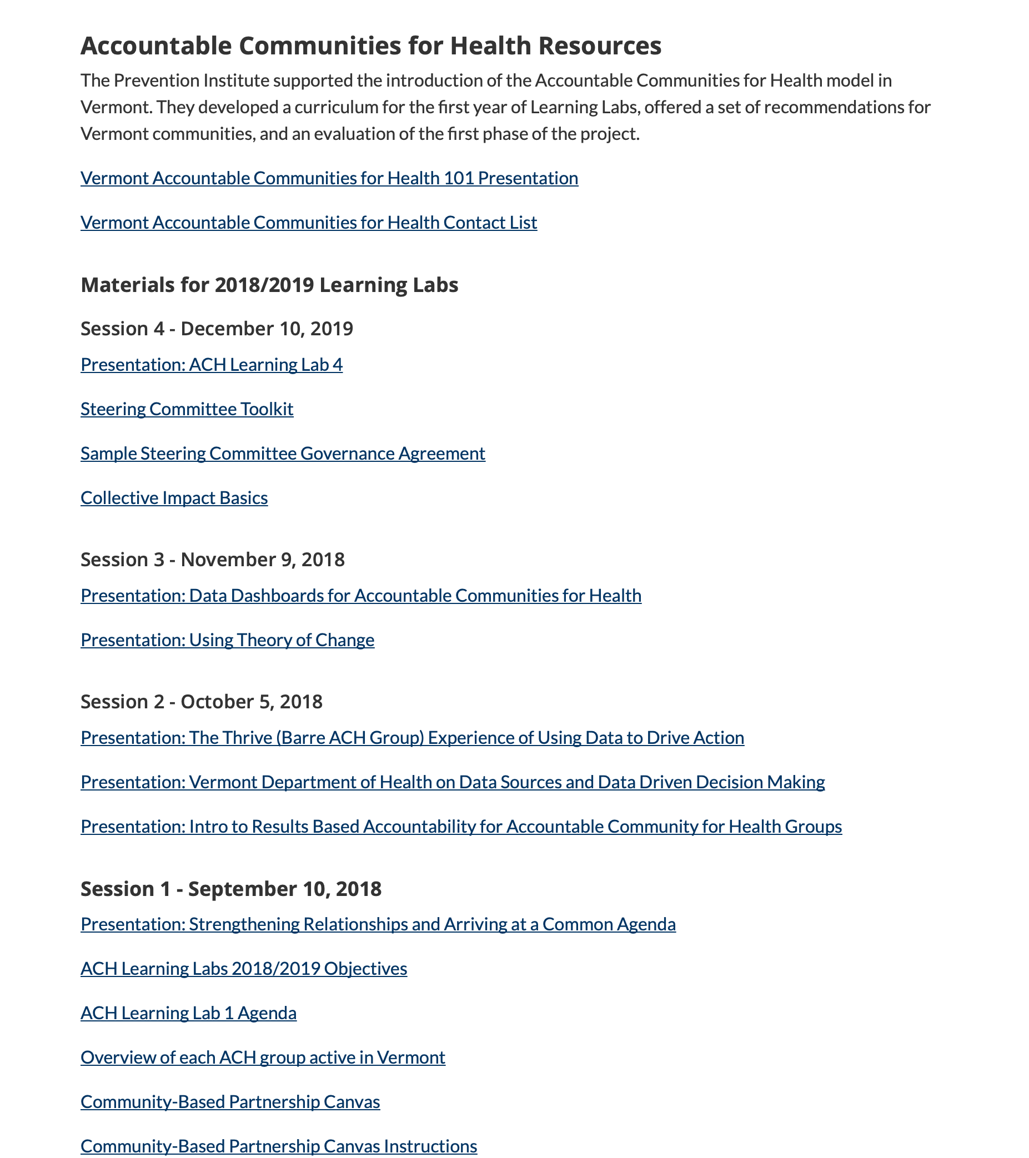
Accountable Communities for Health Resources
https://blueprintforhealth.vermont.gov/about-blueprint/accountable-communities-health

Slide 5
The Core Element of Sustainable Financing
What are you trying to pay for and what are your options?

Slide 6
Sustainable Financing
An ACH requires resources to support both its integrator function and ACH implementation work across ACH partners. An ACH should strive to build a diverse funding portfolio, making use of existing and new funding sources that advance broad community goals. The ACH should have demonstrated capacity to manage the fiscal operations of their organization, including the collaborative development and implementation of a sustainability plan, and the articulation of the value their collective actions have contributed to their community. It is imperative that the ACH operate in a fiscally transparent manner to maintain trust and accountability to the community.

Slide 7
What are you trying to pay for?
Backbone/Integrative Activities?
Interventions?
Capital Project?
Not sure/Something else?

Slide 8
Objectives
Learn from one another:
How resource integrator functions and implementation activities are being funded
How to create and articulate your ACH’s value
How to start an ACH financial plan

Slide 10
Objective 1 - Integrative Activities
Roles and leadership functions for governing and managing the work happening in your ACH
How does your ACH currently fund its integrator activities? (convening stakeholders, analyzing and planning for regional health improvement, governance, strategy, finance management, monitoring and evaluation)

Slide 11
What Funding Options Exist?
Grants
Loans, bonds, equity investments
Value-based health care payments
Reinvestment
Public revenues
Public appropriations
Institutional purchasing and investing
Mandates
Earned Income

Slide 12
Objective 2 - Articulating Value
Demonstrating the value your ACH is creating from an intervention or integrative activity.
Describe the activities your ACH performs
Can you describe the results your ACH has achieved?

Slide 13
Value
Social Value – improves societal/environmental condition or quality of life for the general population
Economic Value – places $ value on social benefits to quantify the effect they will have on the economy
Organizational Value – advances the mission, enhances reputation, or competitiveness

Slide 14
Value: Who Benefits?
For whom are you creating value?
Can you describe the impact your ACH has had on the quality of people’s lives?
Can you describe the financial, social/economic, and organizational value your ACH has created?

Slide 15
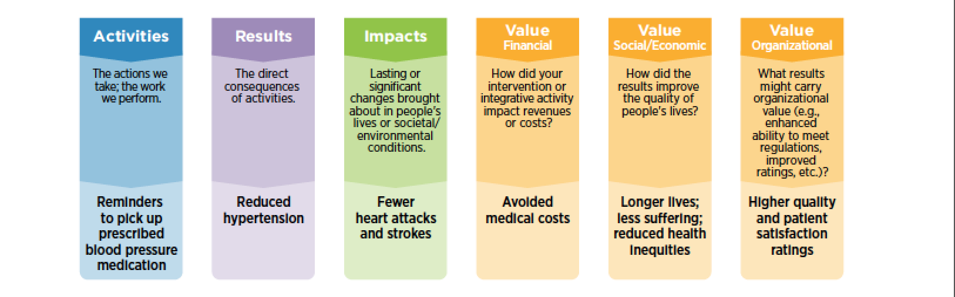
Demonstrating ROI
Searching existing evidence
Conducting an evaluation
Construct a value sequence
Notes:
Why define your ROI!
Which interventions have the best ROI?
You’re going to test out a new intervention
You’re already doing integrative activities or interventions and want to understand the ROI
If your intervention is evidence-based, you may find that the ROI and/or cost-benefit ratio has already been calculated.

Slide 16
Objective 3 – Building a Financial Plan
Current and future intended uses of money and predicted sources of income (could describe a regional investment portfolio, a multi-year plan for an intervention, and/or funding for integrative activities).
How do you capture what your ACH needs money for, how much, where from, and over what period of time?

Slide 17
Based on what we discussed, what are you hoping our presenters might touch on in more depth today?

Slide 18
Additional Resources
Financing Population Health
Bridging for Health – Innovations in Financing for Community Health
Place Based Investing – Creating Sustainable Returns and Strong Communities

